Slide 1
Redistricting in Oroville:
Public Input and Communities of Interest
Q2 Data & Research, LLC
November 18, 2021

Slide 2
Today’s Agenda
Introduction & Background
What is Redistricting?
Laws Governing Redistricting
Criteria for Redistricting
Communities of Interest
Process Timeline
How to Get Involved

Slide 3
Introduction and Background
In 2020, the City of Oroville converted from at-large to by-district elections
This move was prompted by action brought under the California Voting Rights Act (CVRA)
Cities throughout California have transitioned from ‘at-large’ to ‘by-district’ elections due to the CVRA
The City of Oroville now has 6 city council districts
City Council members must live in their district to be eligible to represent it
Voters in each district elect the council member for their district

Slide 4
Districting versus Redistricting
Districting is the process of creating districts where there were none before
Redistricting is the process of adjusting the existing district boundaries
Redistricting usually happens every 10 years after the release of the decennial Census
Decennial Census data are used to equalize the populations of the districts
Redistricting provides the opportunity to bring the existing districts into compliance with all redistricting criteria

Slide 5
Access Tools
The City will make a free, online mapping application available to the public
The online mapping tool will allow members of the public to create digital input and draw maps
Proposals developed with the online mapping tool can be submitted to the City for consideration
The tool will allow users to view census geography and data for any area of interest within the City boundaries.

Slide 6
What are the mapping criteria?
Criteria Ranked in Order of Priority (“to the extent practicable”)
Compliance with US and CA Constitution (equal population)
Compliance with Federal Voting Rights Act (FVRA addresses race and language minorities)
Contiguity
Respect for* local neighborhoods and Communities of Interest (COIs)
COIs may not include relationships with political parties, incumbents, or political candidates.
Boundaries should be easily identifiable and understandable by residents
Compactness: If it doesn’t conflict with preceding criteria
Do not favor or discriminate against political parties
*Respect for means minimize divisions

Slide 7
Ideal Population Per District
To Compute the ideal population for each type of district:
Total population ÷ # of districts = Ideal POP
Oroville total Population from 2020 Census: 20,191
Ideal population for Oroville City Council Districts?
20,191 ÷ 6 = ~3,365 people per/district

Slide 8
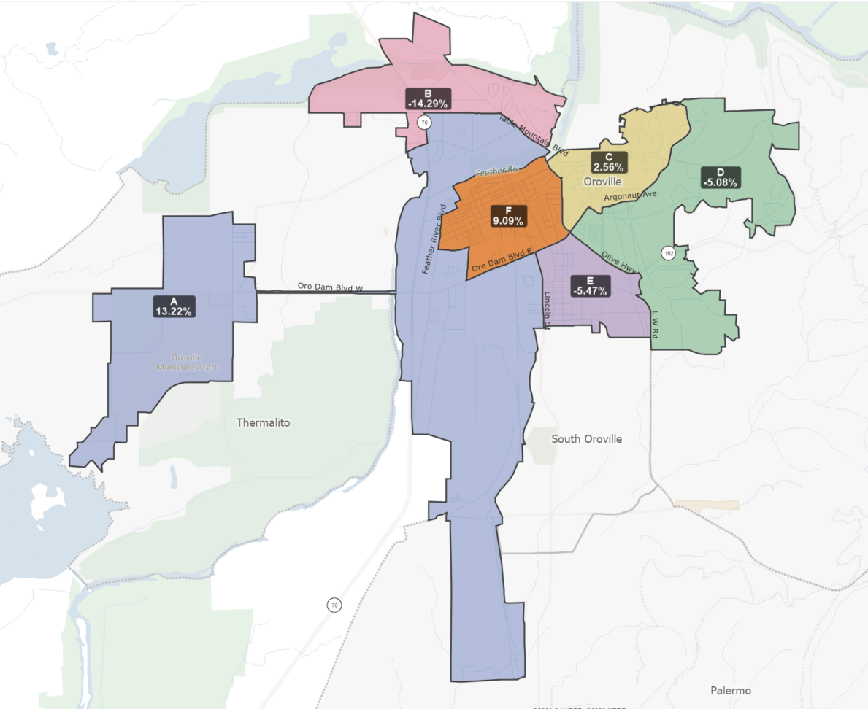
District A : +13.22%
District B: -14.29%
District C: +2.56%
District D: -5.08%
District E: -5.47%
District F: +9.09%
2021 Assessment of Current Oroville City Council Districts

Slide 9
Criterion 4: Local Neighborhoods and Communities of Interest (COIs)
Neighborhoods are specific to each jurisdiction
They are sometimes defined by the jurisdiction and more frequently by the residents that live in a certain area.
“Communities of Interest” are generally described as a geographic area comprised of residents who share similar interests.
COIs are defined by those familiar with the community...
Law does not limit the kinds of interests that may bind a community.
It is up to those who live in or work with a community to identify and establish the interests that unite it.
Interests need not be limited to current situation but can also include common goals.

Slide 10
Common Interest Examples:
Economic interests:
Current situation -- common employment or economic opportunities (or lack thereof).
Goals -- expanding opportunities, development, bringing in businesses, and jobs, etc.
Social interests:
Current -- schools, culture, transportation, parks
Goals -- improving recreational opportunities or public safety, preserving historic resources, etc.
Neighborhoods are often thought of as Communities of Interest

Slide 11
How to document your COI
Please answer the following questions:
What bonds your community?
Outline what defines the COI:
What is your mission or commonality?
Explain what is different outside of the boundaries of your Community of Interest
Where is your community located in the City?
Create a map of the boundaries (use Google maps, GIS/mapping program, paper, etc.)
Write down the boundaries
Residents will also receive instructions on how to use the State’s Community of Interest tool to map their COIs and submit them to the City.
Please submit COI Testimony by December 15, 2021, to be considered in the Draft Map(s).

Slide 12
Timeline Overview
Hearing 1: October 19, 2021
Kickoff and training for the public and Council
Hearing 2: November 18, 2021
Public input session, collect Communities of Interest
Community Workshop: December 15, 2021, time TBD
Hearing 3: December 16, 2021
Live Mapping of Draft Maps
By December 20, 2021: Post Draft Map(s) on website for public comments

Slide 13
Timeline Overview
Hearing 4: January 6, 2022
Feedback on the draft map(s)
Live Mapping to make adjustments
Hearing 5: January 18, 2022
Feedback on the draft map(s)
First reading of the ordinance
Hearing 6: February 1, 2022
Second reading of the ordinance

Slide 14
Why should you participate?
To make sure we know about your Community of Interest.
To give your community a voice and make sure it has equal access to the political process.
To encourage citizens to register, vote, and remain politically engaged.
To help shape a redistricting plan that provides communities a meaningful opportunity to elect candidates who represent their interests on issues that are important to their lives.

Slide 15
How to Get Involved
To participate in the process: testify, submit written testimony, send supporting information to the City
Please provide information about your Community of Interest, or other topics the City needs to know about as soon as possible.
Submit information at a hearing, by mail, or drop off at: Oroville City Hall, 1735 Montgomery Street, Oroville CA
Via email:
Via Phone:
Get information online:
THANK YOU FOR PARTICIPATING!!!

Slide 16
Thank you!
Questions?

