Slide 1
FOLLOW THE MONEY …
How was the $11,270,000 up front funds of the Settlement Agreement
provided by SWC/DWR used to benefit the Oroville Area …

Slide 2
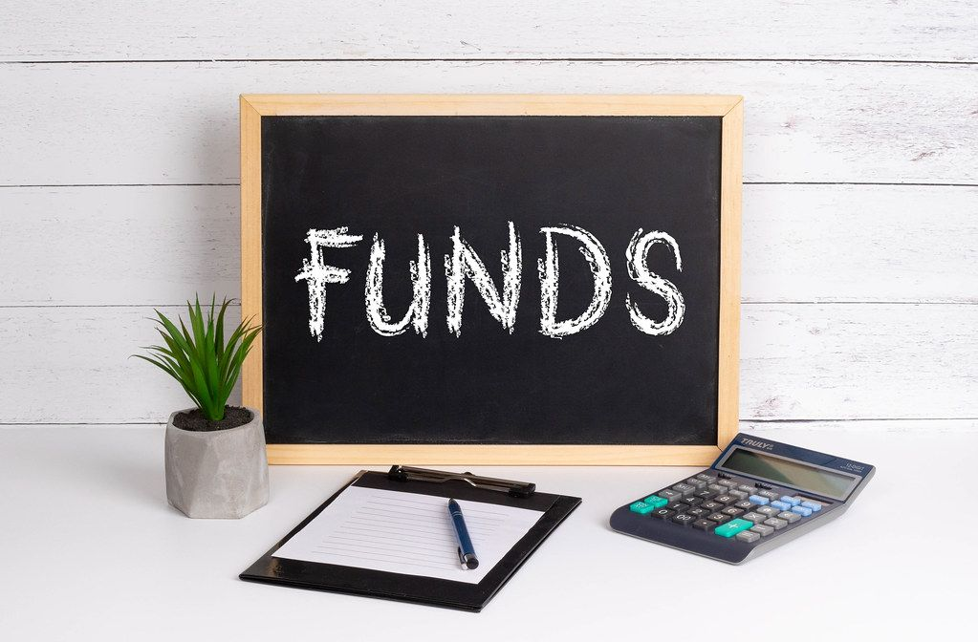
$11,270,000 up front funds & % Distribution 2007-2023
FRRPD Grants * 66.56
Community Grants 15.10
City of Oroville Grants 2.00
Chamber of Commerce Grants 3.00
Event Coordinator (seven years) 2.00
Studies 2.00
Administration 9.32
Unencumbered .02
* Includes $5,200,000 for phase I & II of Riverbend Park

Slide 3
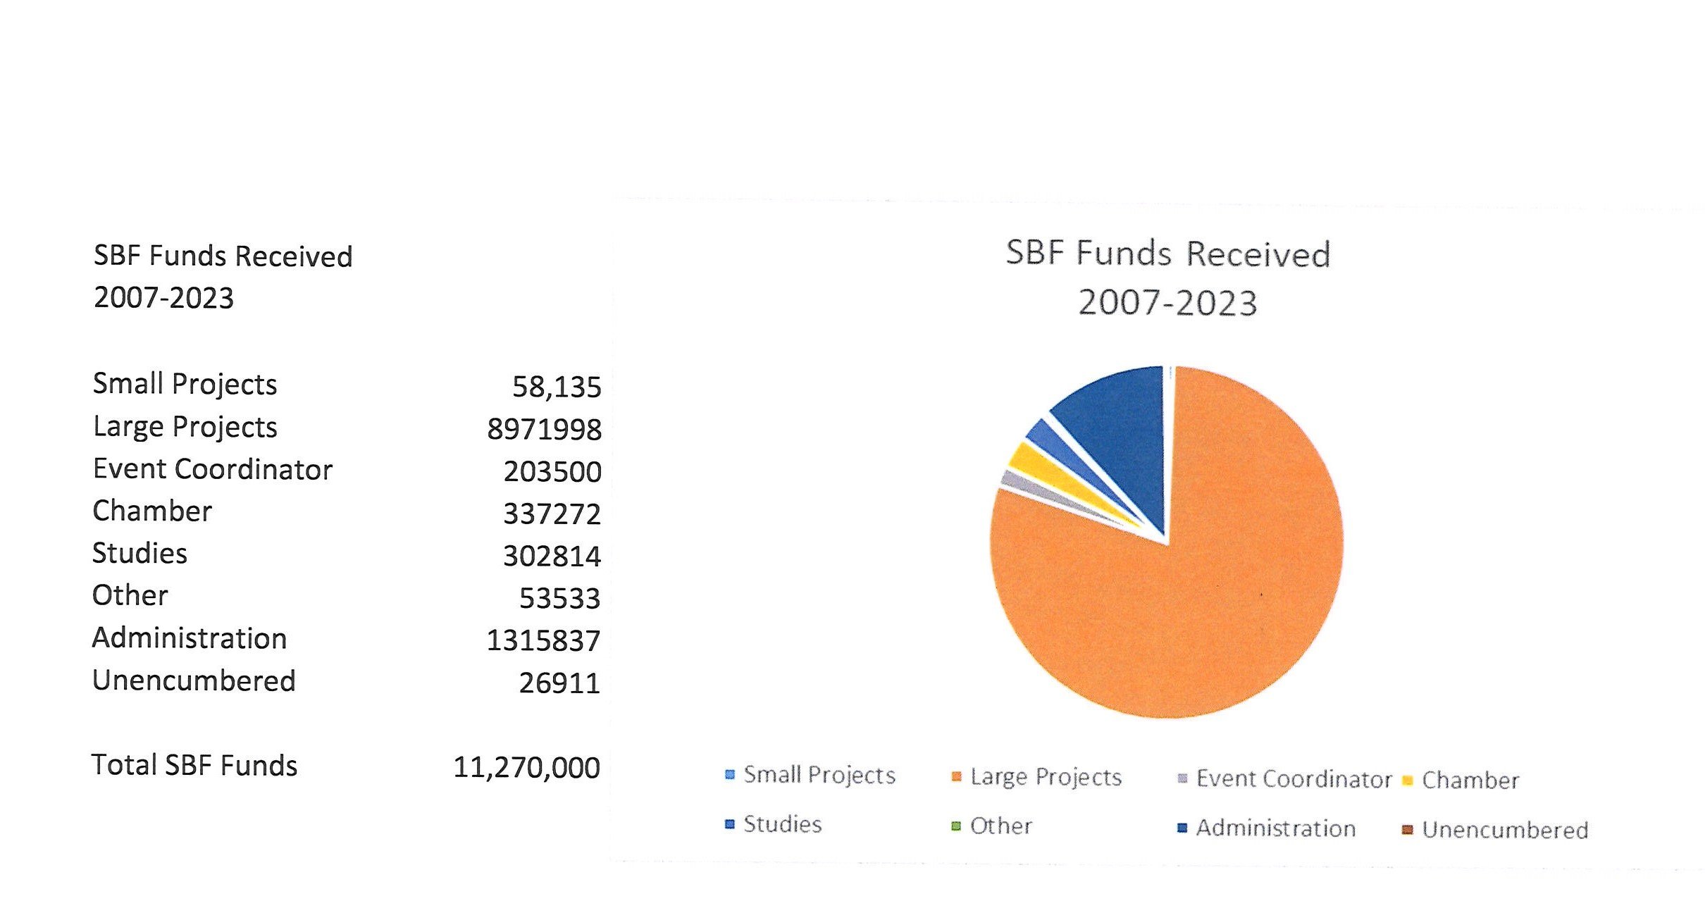
From Settlement Agreement Exhibit A, Attachment 1 Page 4 of 10 ($11,270,000)

Slide 4
LARGE PROJECTS
2007-2023 $8,971,998

Slide 5
Riverbend Park Phase I & Phase II $ 5,200,000
All-purpose Fields (Soccer) @ Riverbend Park $ 1,012,221
Table Mountain Golf Course/Irrigation Enhancements $ 30,000
GEM cars for City of Oroville Police Department $ 35,098
Forebay Aquatic Center (Feather River Center) $ 399,474
Oroville Veterans’ Memorial $ 276,171
Nelson Complex Irrigation Repairs $ 24,000
Playground at Riverbend Park $ 50,000
Thermalito Family Center/Nelson Pool $ 750,000
State Theatre $ 1,013,500
YMCA Pool locker/restroom repairs $ 75,000
Birdcage Theatre $ 25,000
ODBA Marketing $ 41,500

Slide 6
Historic State Theatre $ 667,500
Brad Freeman Trail (missing link completion) $ 410,760
Renovate Minors Alley $ 55,000
Table Mountain Bridge LED Lighting Project $ 100,000

Slide 7
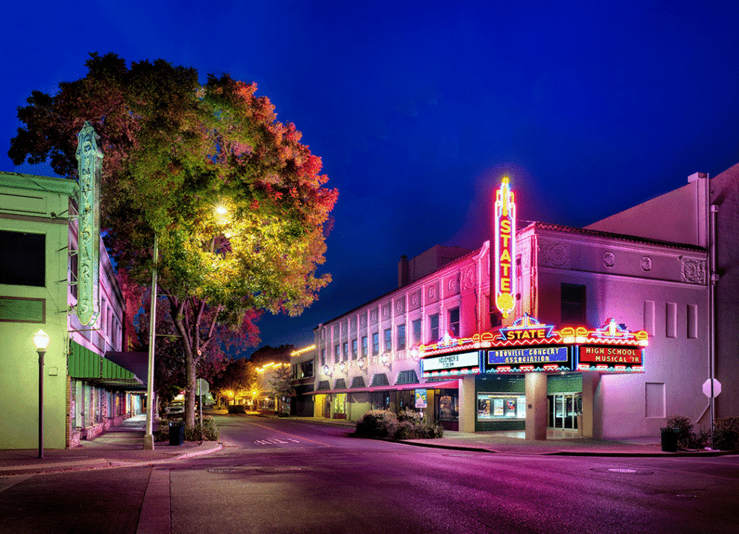
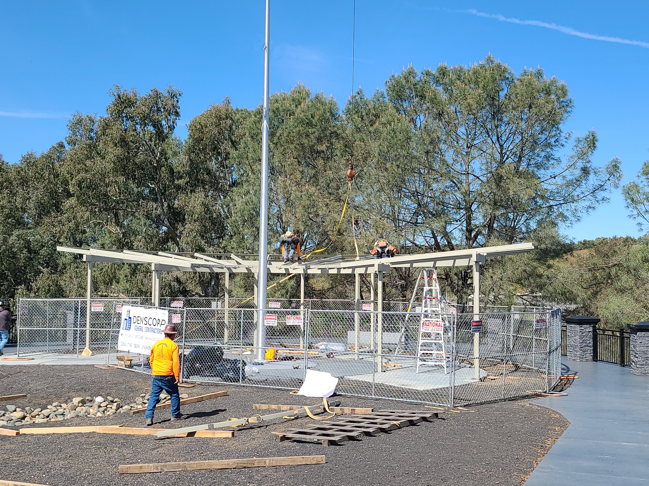
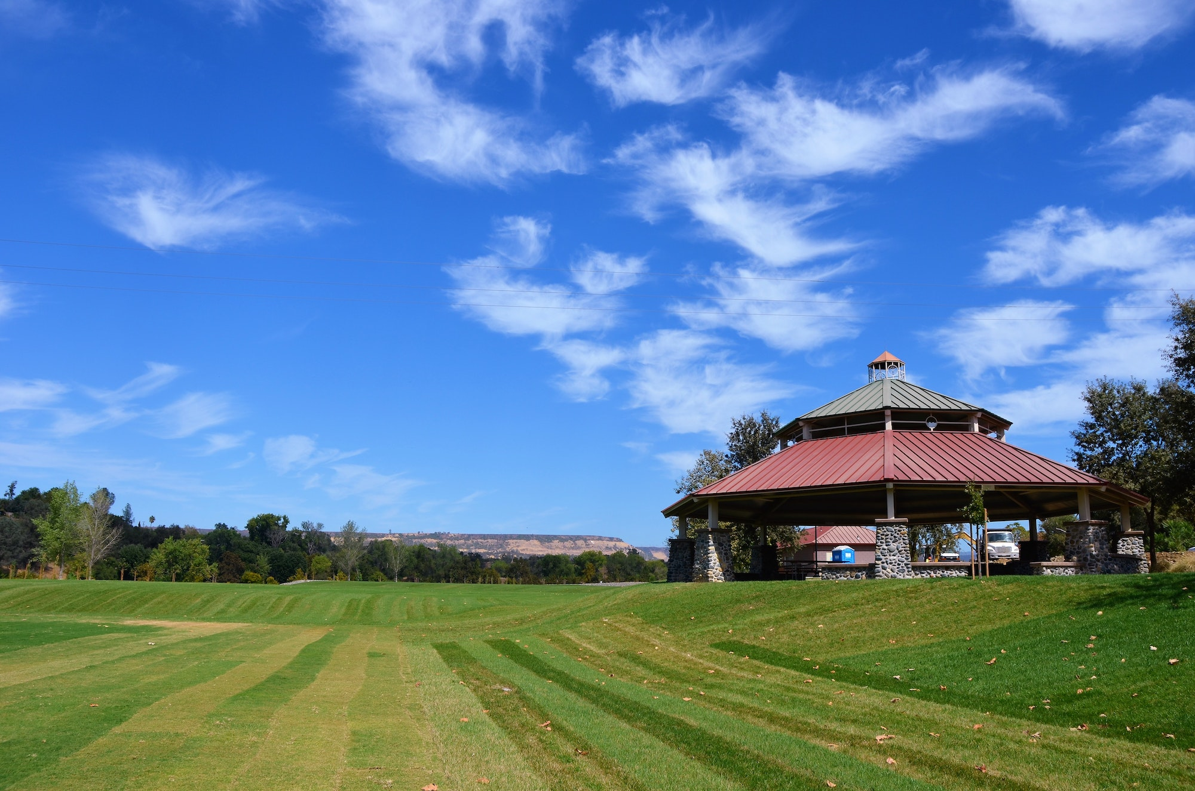
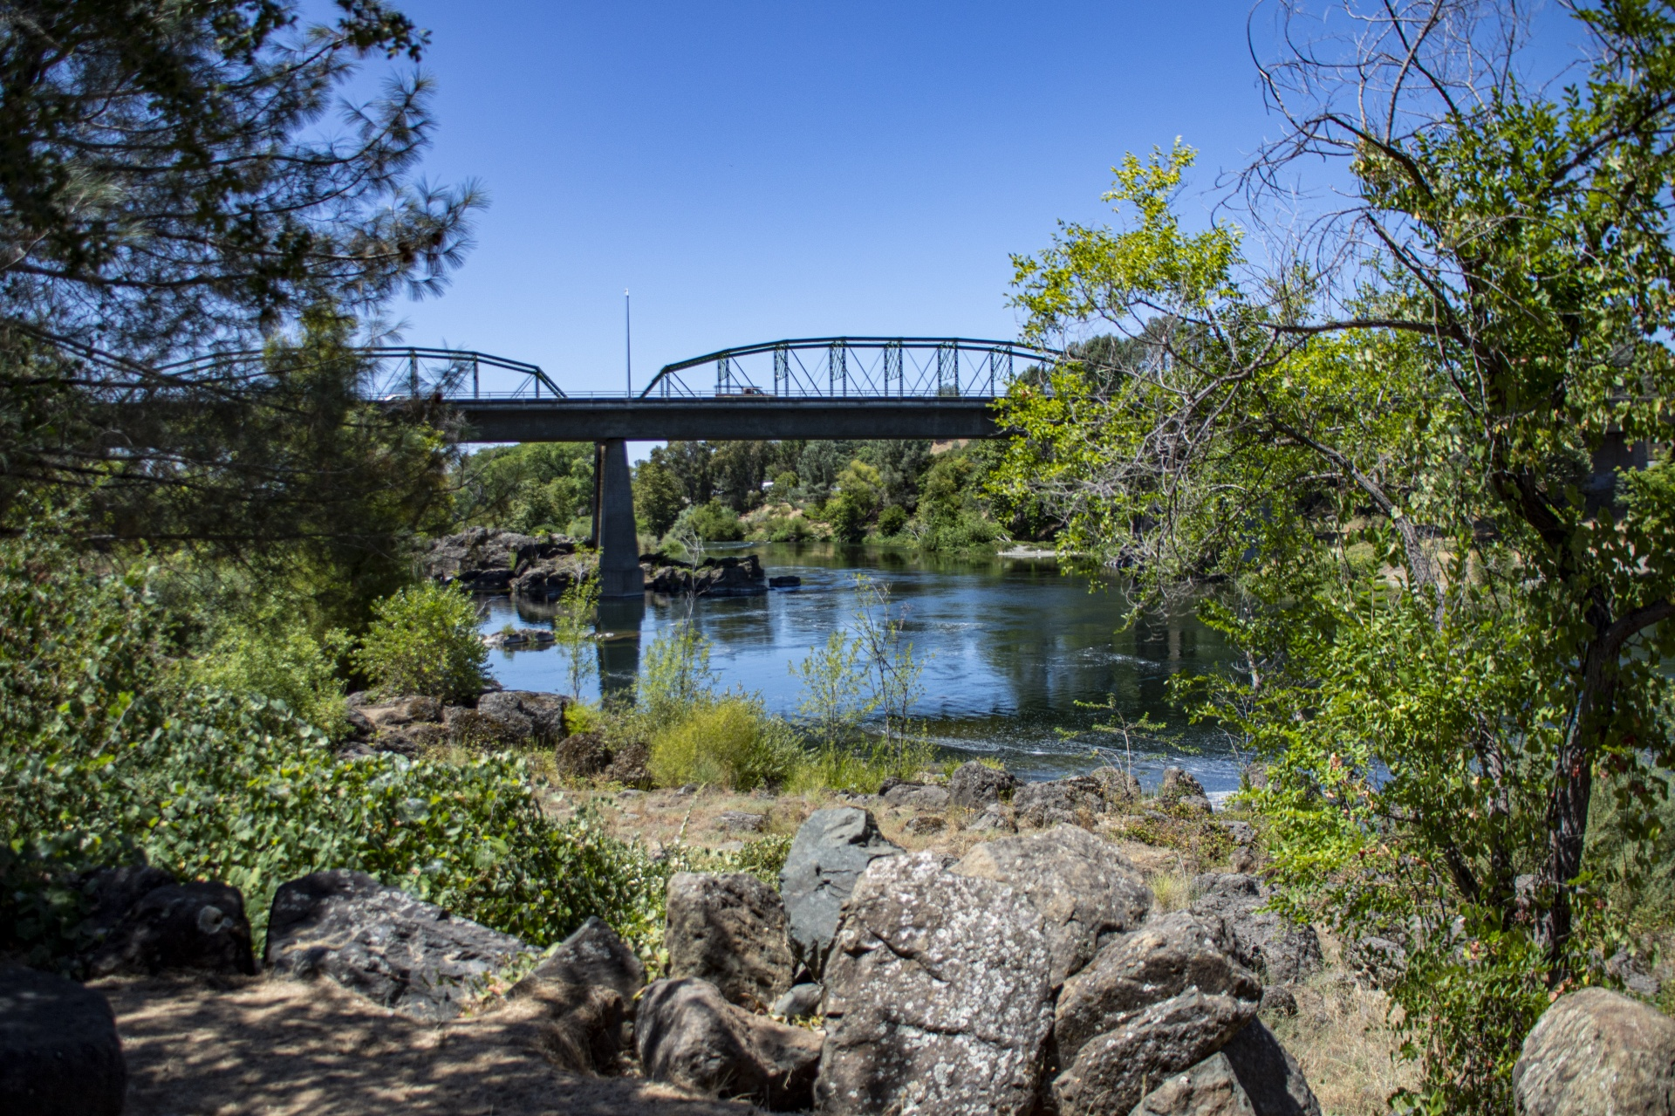

Slide 8
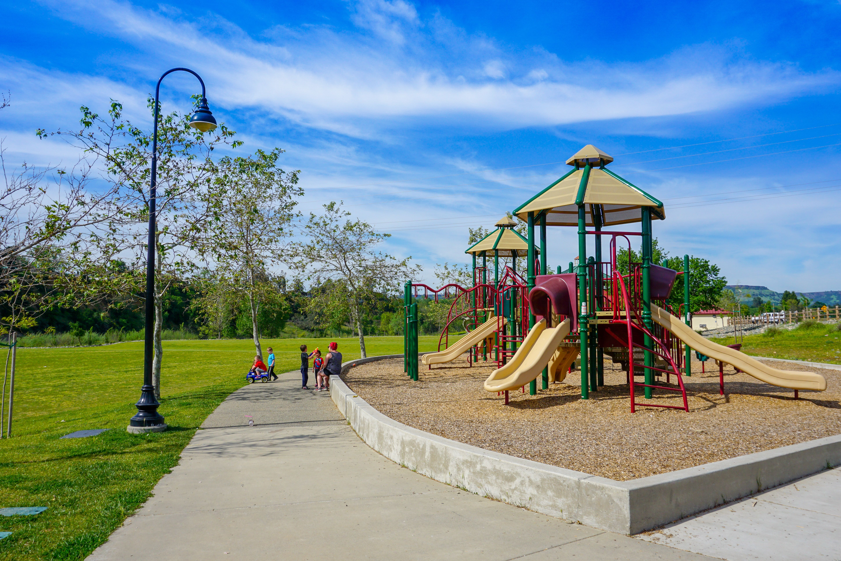
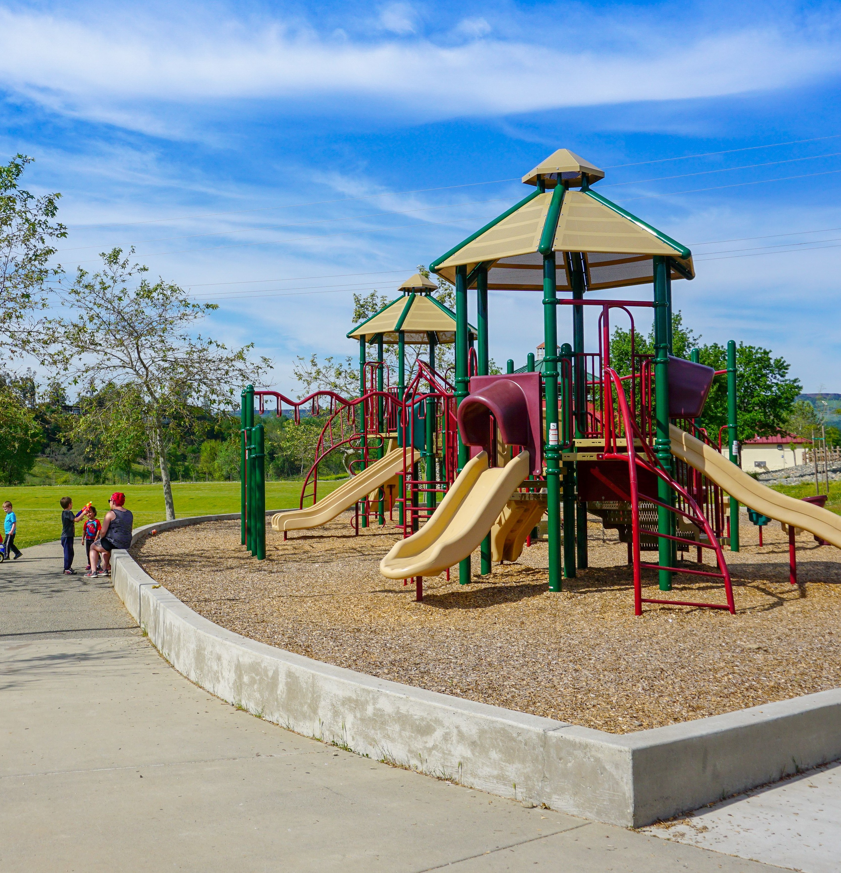
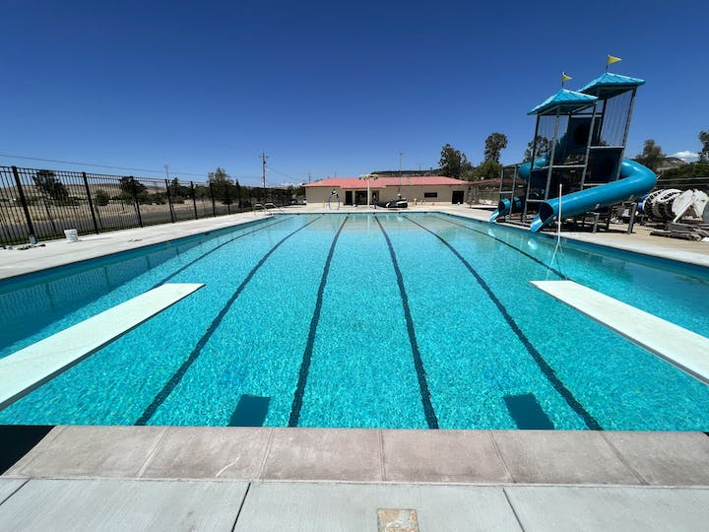

Slide 9
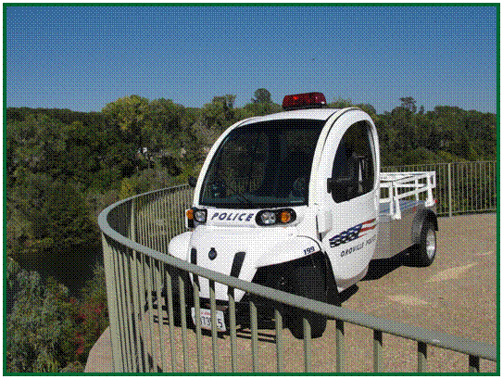
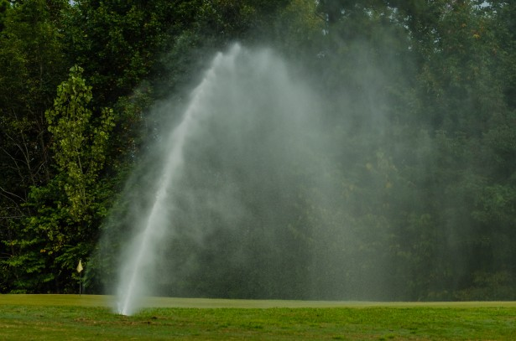
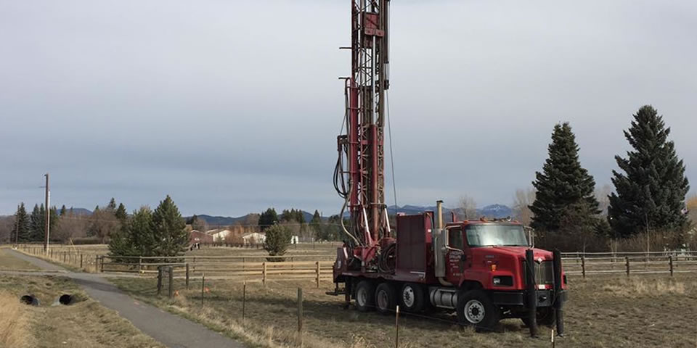

Slide 10
SMALL PROJECTS
$58,135

Slide 11
Kids at Risk Sports Investment & Intervention Program $ 5,000
The Pottery Project (a kiln for Artists of Rivertown) $ 4,400
Oroville YMCA (pool repairs) $ 5,000
Eagle Metal Sculpture $ 5,000
City of Oroville Fire Department Water Rescue Equipment $ 4,637
Chinese Brick Building/Landscape near Bolt Museum $ 4,000
Oroville Branch Library conference room upgrades $ 4,835
Oroville Gone Wild, Nature & Wilderness Program $ 5,000
Metal Sculptures at the Feather River Nature Center $ 3,624
FRRPD: Marketing, Website, Disc Golf Promotion $11,670

Slide 12
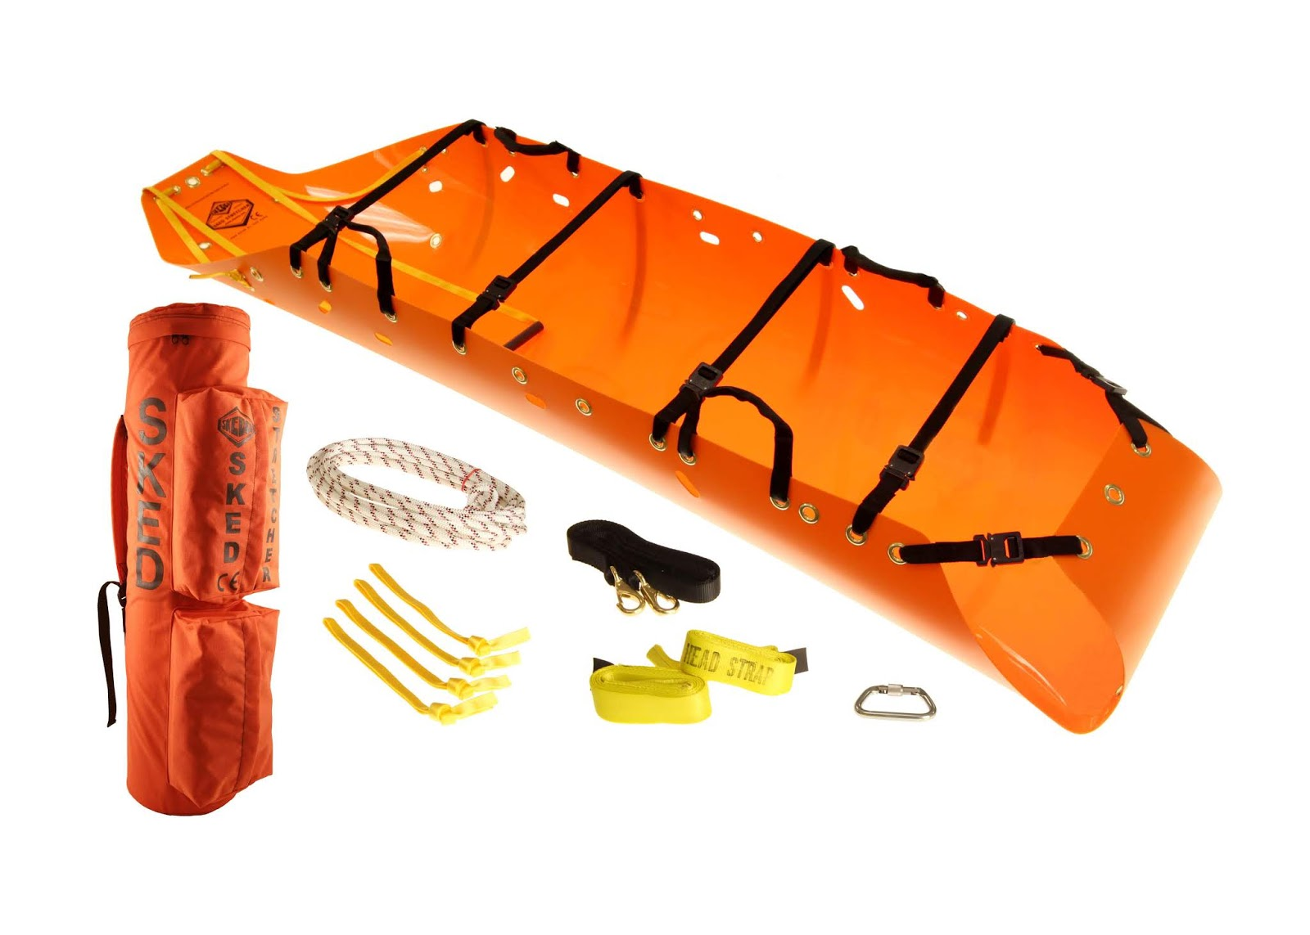
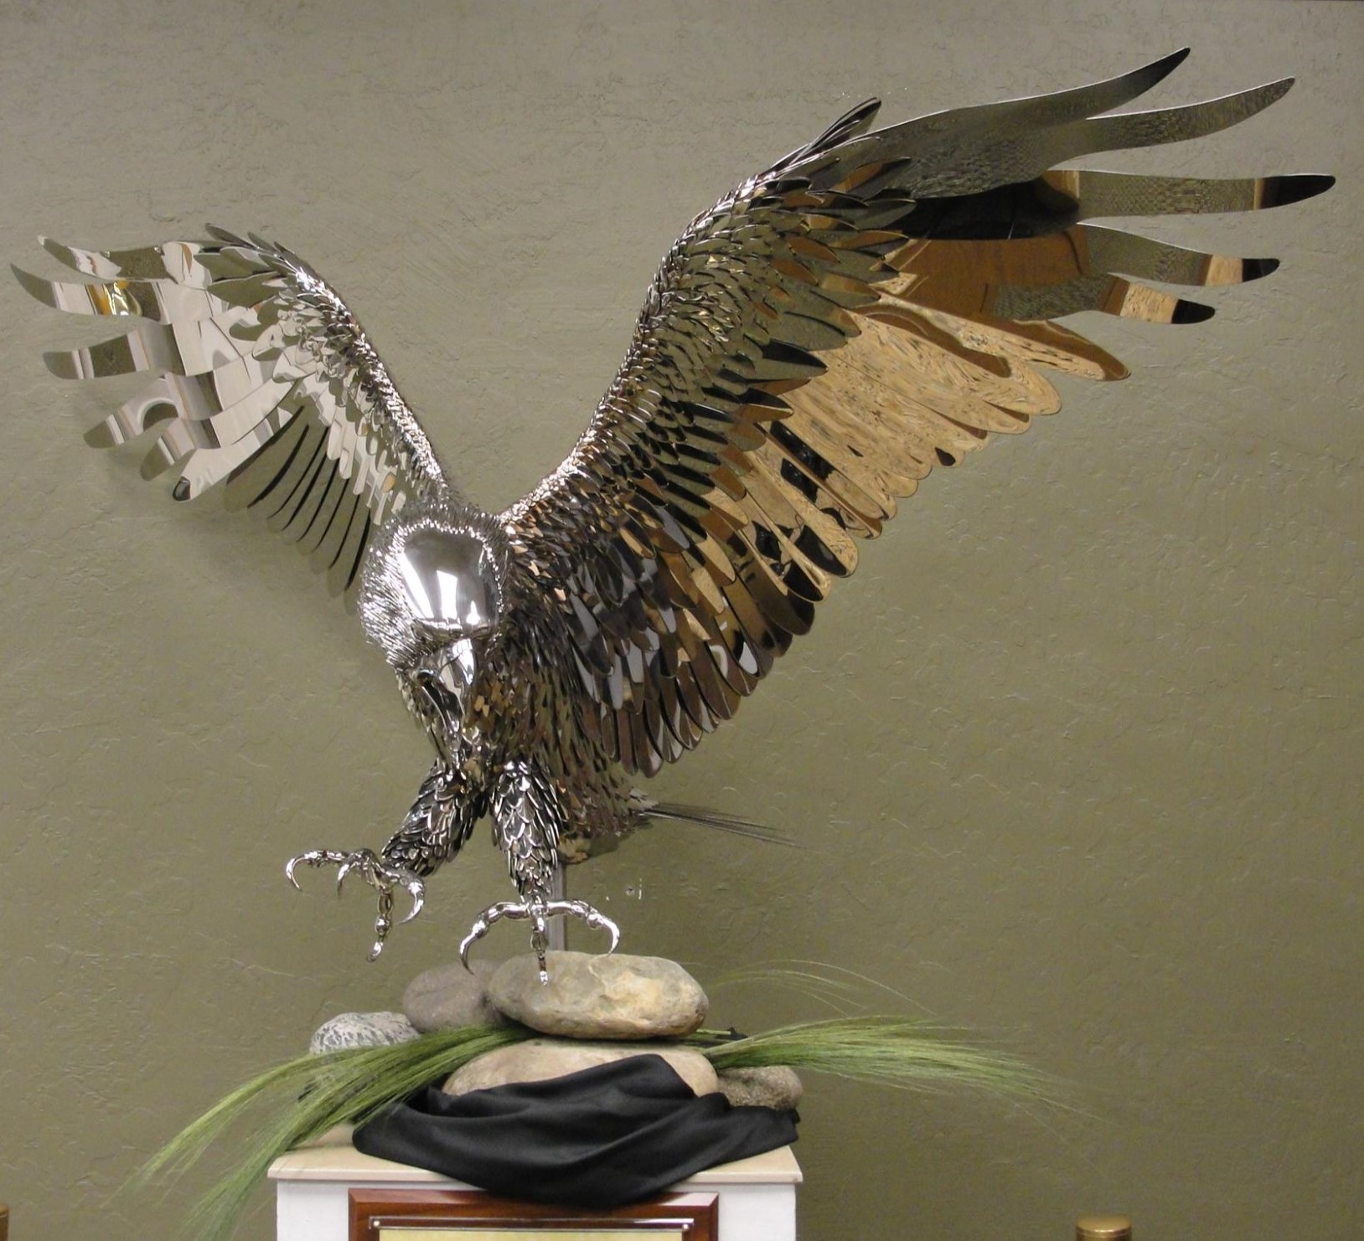
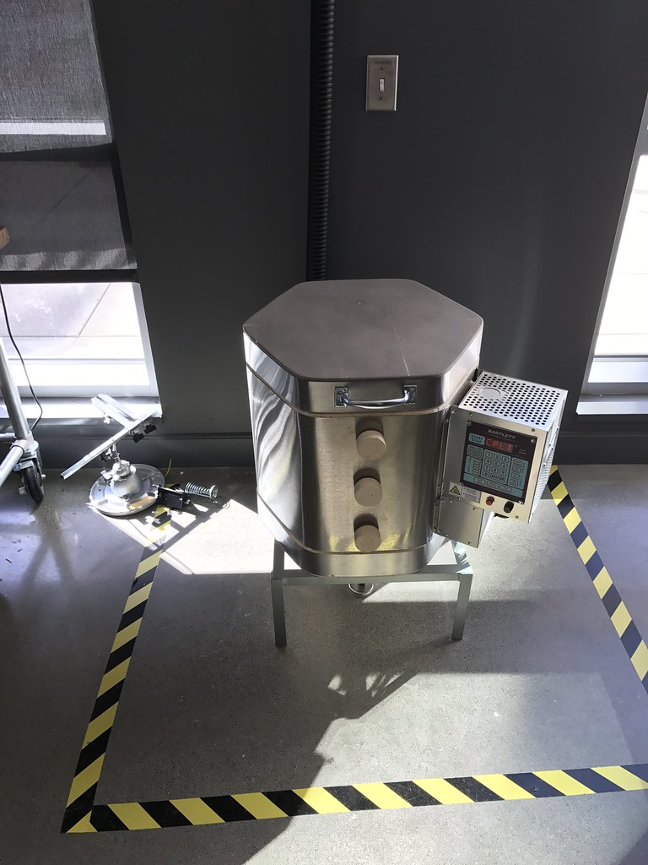

Slide 13
DIRECT BEQUESTS
2007-2023 $53,533

Slide 14
DIRECT BEQUESTS
City of Oroville/fund one (1) MLE for one year for Park & Trail Patrol
$48,403.20
Brochures & Lake Oroville Tourism Maps
$9,969.23

Slide 15
EVENT COORDINATOR
2007-2023 $203,500

Slide 16
2015-2021
Upstate Community Enhancement Foundation
Coordinated meetings & events for:
Feather Fiesta Days
Fourth of July
Salmon Festival
Downtown Parade of Lights

Slide 17
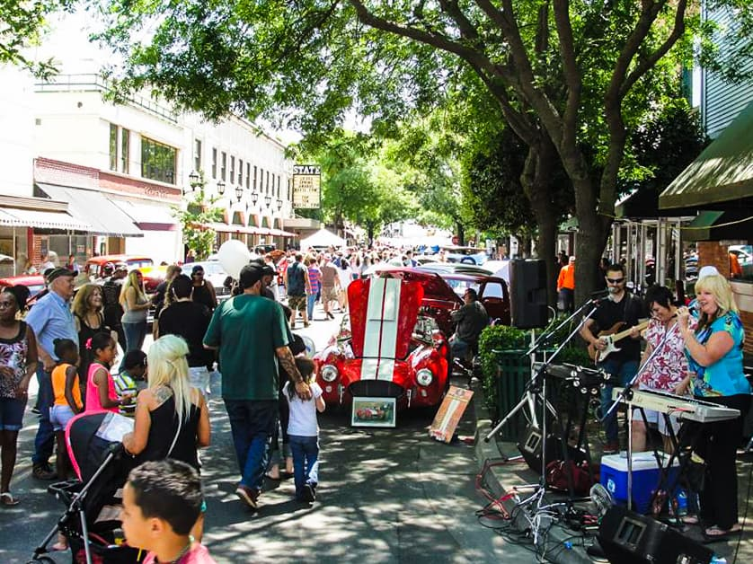
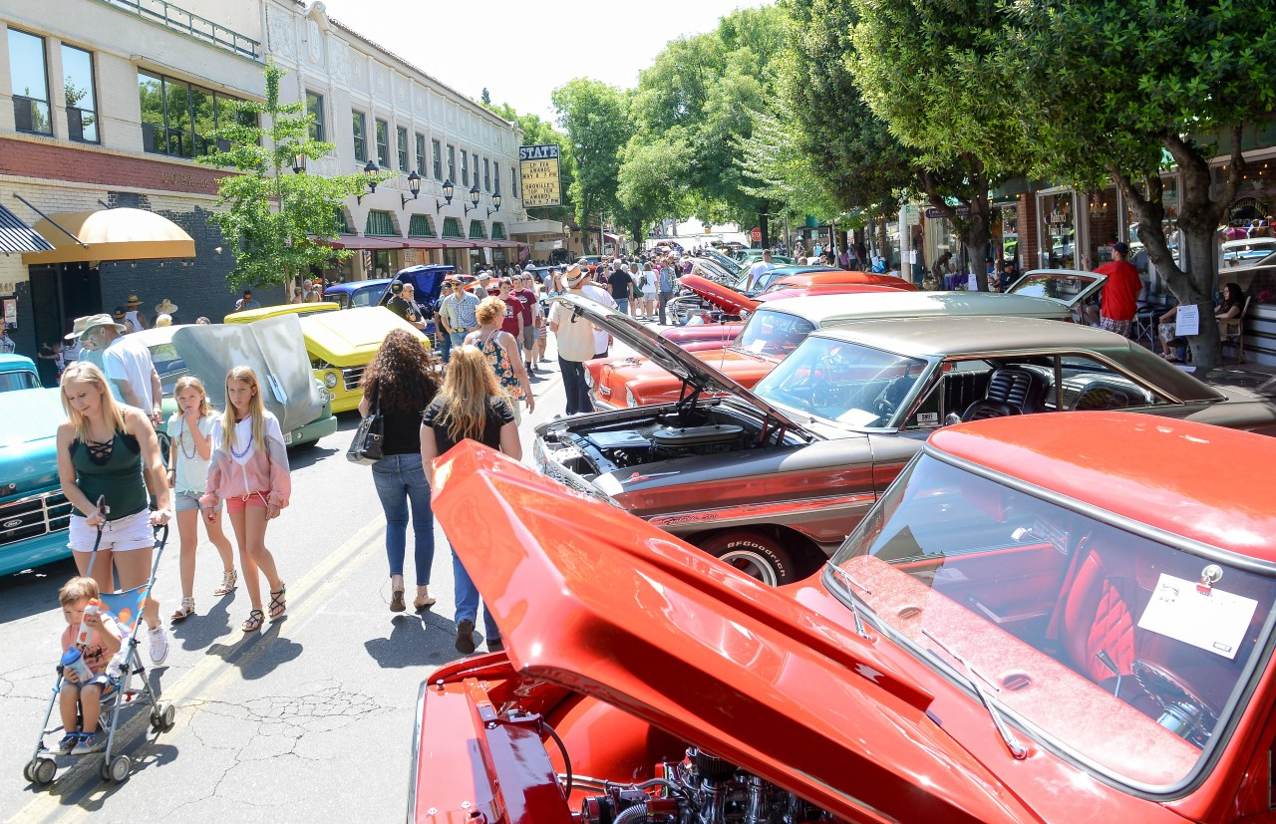
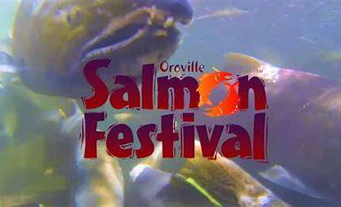
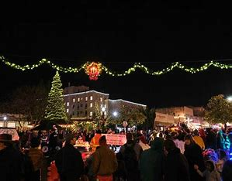
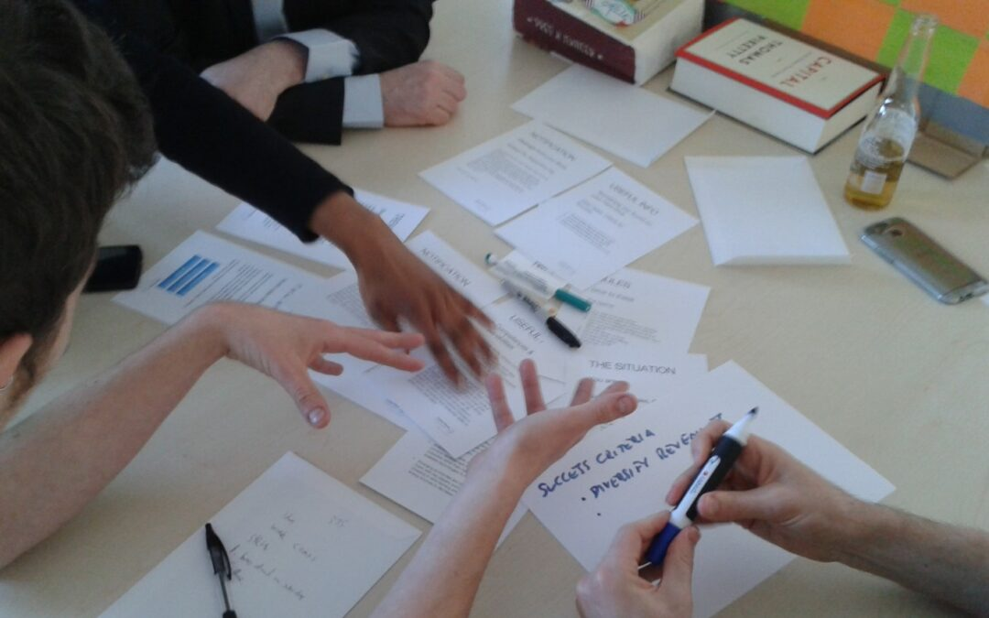

Slide 18
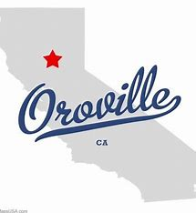
CHAMBER OF COMMERCE
2007-2023 $337,272

Slide 19
CHAMBER OF COMMERCE/MARKETING THE OROVILLE REGION (FIXED)
This fixed funding category provides a consistent annual grant of $60,000 to the Oroville Area Chamber of Commerce (Chamber) for tourism and community event activities within the boundary scope of the SBF. Annually, the Chamber will submit a budget for anticipated usage of the grant funding.
The Chamber submission, which will be provided in lieu of a formal application, will require Steering Committee review and approval. Aside from SBF funding, the Chamber is encouraged to obtain matching funds for activities from its members, the general public and other available grant sources.
SBF reimbursement to the Chamber will be made upon receipt and approval of a summary report with documentation substantiating the expenditures.

Slide 20
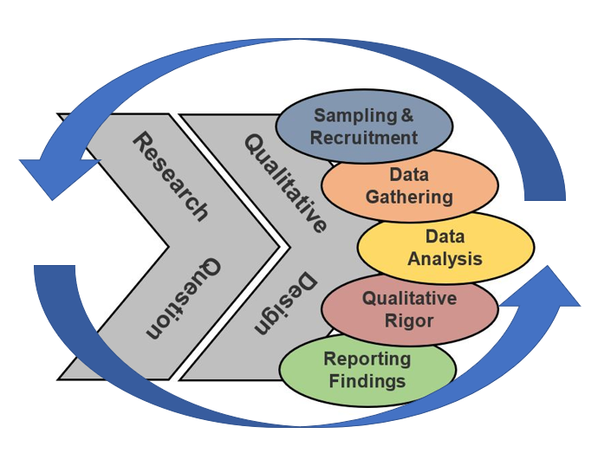
STUDIES
2007-2023 $381,568

Slide 21
Regional Fund Strategic Plan (Required) $ 173,500
Whitewater Study (Optional) $ 89,118
Feather River Conceptual Plan (Insure project focus) $ 68,950
Brad Freeman Trail Conceptual Design (Optional) $ 30,000
Brad Freeman Trail Environmental Study (Optional) $ 20,000

Slide 22
ADMINISTRATION
2007-2023 $1,315,837 (11.7%)
.5 FTE employee of City of Oroville (2008-2019) salary, benefits & supplies
1.0 FTE employee of City of Oroville (2019-2022) salary, benefits & supplies
10 hours per month consultant (2022-2024)
Other expenses: Legal, postage, Xerox, meetings, publishing

Slide 23
Questions ????

