Slide 1
SBF Steering Committee Class 101 Presented by Bob Marciniak on July 26, 2023

Slide 2
BASICS OF A COMPLICATED AGREEMENT …
SETTLEMENT AGREEMENT
FOR LICENSING OF THE OROVILLE FACILITIES
FERC PROJECT No. 2100

Slide 4
The original license …
.
On February 11, 1957, the Department of Water Resources (DWR) was issued a 50-year license to construct and operate the Oroville facilities (P-2100).
The original license expired on January 31, 2007 and P-2100 is currently operating under an annual license that automatically renews each year until a new license is issued.
[Add a graphic that provides evidence of what you learned]
Notes:
Notes to presenter:
Description of what you learned in your own words on one side.
Include information about the topic
Details about the topic will also be helpful here.
Tell the story of your learning experience. Just like a story there should always be a beginning, middle and an end.
On the other side, you can add a graphic that provides evidence of what you learned.
Feel free to use more than one slide to reflect upon your process. It also helps to add some video of your process.

Slide 5
Many meetings & studies …
During relicensing, a diverse group of agencies and stakeholders scoped issues, designed a $27 million suite of studies, reviewed reports, proposed measures, and discussed potential solutions for project impacts. Using relevant information from this effort, DWR filed an Application for New License with supporting environmental documentation on January 26, 2005.

Slide 6
Signing of the Settlement Agreement
On March 26, 2006, DWR and an overwhelming majority of stakeholders successfully concluded negotiations and signed a Settlement Agreement that has been estimated to provide approximately $1 billion in environmental, recreational, cultural, and other benefits over a proposed 50-year new license term.

Slide 7
The Stakeholders … in alphabetical order
Alameda County Flood Control
Alameda County Water District
American Rivers
American Whitewater
Antelope Valley-East Kern Water District
Berry Creek Citizens Association
California Department of Boating & Waterways
California Department of Fish & Game

Slide 8
The Stakeholders … in alphabetical order
California Department of Parks & Recreation
California Department of Water Resources
California State Horseman’s Association
California State Horsemen's Region II
Castaic Lake Water Agency
Central Coast Water Authority
Chico Paddleheads
Citizens for Fair & Equitable Recreation

Slide 9
The Stakeholders … in alphabetical order
City of Oroville
Coachella Valley Water District
County of Kings
Crestline-Lake Arrowhead Water Agency
Desert Water Agency
Empire West Side Irrigation District
Feather River Low Flow Alliance
Feather River Recreation & Parks District

Slide 10
The Stakeholders … in alphabetical order
International Mountain Bicycling Association
Kern County Water Agency
Kon Kow Valley Band of Maidu
Lake Oroville Bicyclist Organization
Littlerock Creek Irrigation District
Metropolitan Water District of Southern California
Mojave Water Agency
Napa County Flood Control & Water Consv. District

Slide 11
The Stakeholders … in alphabetical order
National Marine Fisheries Service
Oak Flat Water District
Oroville Area Chamber of Commerce
Oroville Downtown Business Association
Oroville Economic Development Corporation
Oroville Parks Commission
Oroville Recreation Advisory Committee
Oroville Redevelopment Agency

Slide 12
The Stakeholders … in alphabetical order
Oroville Rotary Club
Palmdale Water District
San Bernardino Valley Municipal Water District
San Gabriel Valley Municipal Water District
San Gorgonio Pass Water Agency
Santa Clara Valley Water District
Solano County Water Agency
State Water Contractors, Inc.

Slide 13
The Stakeholders … in alphabetical order
Town of Paradise
Tularn Lake Basin Water Supply District
United States Department of the Interior
Plus two individual signers
Arthur G. Baggett, Jr.
DC Jones
Butte County participated in the various meetings & negotiations but withdrew prior to signing the SA

Slide 14
More key dates of the SA
February 1, 2007 – FERC issued notice authorizing continued project operations.
May 18, 2007 – FERC issued the Final Environmental Impact Statement with recommended alternatives accepting most of the Settlement Agreement proposals.
April 9, 2007 – U.S. Fish and Wildlife Service issued the Terrestrial Biological Opinion.
November 20, 2007 – Effective date for DWR and PG&E Habitat Expansion Agreement.
May 2007 – DWR issued Final EIR
December 15, 2010 – State Water Resources Control Board (SWRCB) issued the Water Quality Certification pursuant to Section 401 of the Clean Water Act.
December 5, 2016 – National Marine Fisheries Service issued the aquatic Biological Opinion for anadromous fish.

Slide 15
Key points of the Settlement Agreement (SA)
Signed March 26, 2006
Signed by over 50 municipalities, agencies & individuals
The SA was for the purpose of resolving all issues that have or could have been raised by the parties in connection with FERC’s order issuing a New Project License
[Add a graphic that provides evidence of what you learned]
Notes:
Notes to presenter:
Description of what you learned in your own words on one side.
Include information about the topic
Details about the topic will also be helpful here.
Tell the story of your learning experience. Just like a story there should always be a beginning, middle and an end.
On the other side, you can add a graphic that provides evidence of what you learned.
Feel free to use more than one slide to reflect upon your process. It also helps to add some video of your process.

Slide 16
Table of Contents of the Settlement Agreement (8 specific sections with 42 pages)
Section 1: Introduction
Section 2: Purpose of the Settlement Agreement
Section 3: Compliance with Legal Responsibilities and Reservations of Rights
Section 4: Settlement Agreement Commitments and Implementation
Section 5: Dispute Resolution
Section 6: Withdrawal from the Settlement Agreement
Section 7: General Provisions
Section 8: Execution of the Settlement Agreement

Slide 17
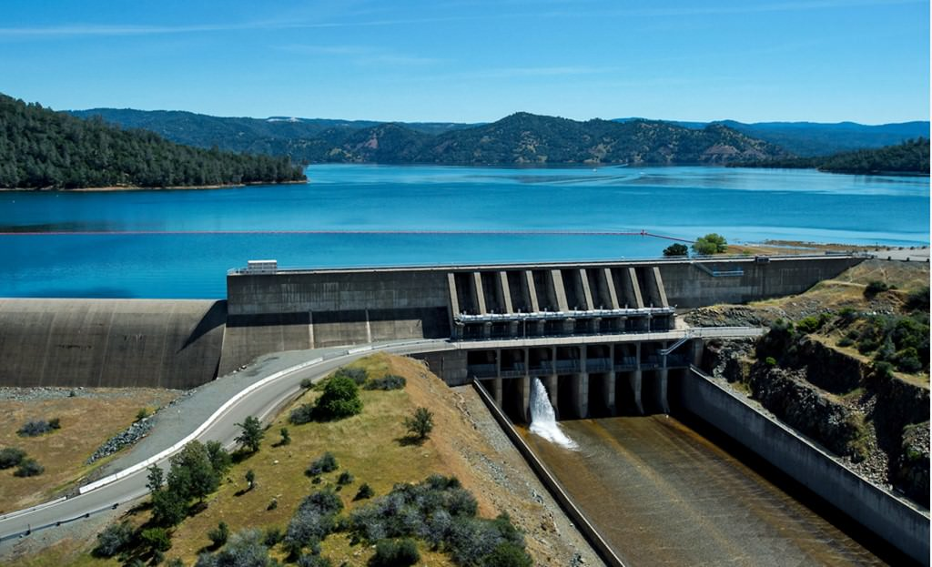
Exhibits & Appendices of the Settlement Agreement (7 appendices with 110 Pages)
Appendix A: Protection, Mitigation & Enhancement Measures Recommended to be included in the New Project License
Appendix B: Measures Agreed to Among the Parties but not to be included in the New Project License
Appendix C: Ecological Committee
Appendix D: SWRCB Collaborative Process Participation Statement
Appendix E: Forest Service Draft 4€ Conditions
Appendix F: Draft Agreement for Habitat Expansion
Appendix G: List of Authorized Representatives

Slide 18
Key points of the Settlement Agreement
Multiple workshops held seeking public input
Signatories of the SA agreed to uphold all of the terms & conditions
All signatories are bound to the terms of the SA provided the New Project License is not inconsistent with the SA
[Add a graphic that provides evidence of what you learned]
Notes:
Notes to presenter:
Description of what you learned in your own words on one side.
Include information about the topic
Details about the topic will also be helpful here.
Tell the story of your learning experience. Just like a story there should always be a beginning, middle and an end.
On the other side, you can add a graphic that provides evidence of what you learned.
Feel free to use more than one slide to reflect upon your process. It also helps to add some video of your process.

Slide 19
Key points of the Settlement Agreement
Protection, Mitigation and Enhancement Measures are made a part of the SA
Biological Opinion must be consistent with the SA
A Habitat Expansion Agreement provides for protection of existing fish species
[Add a graphic that provides evidence of what you learned]
Notes:
Notes to presenter:
Description of what you learned in your own words on one side.
Include information about the topic
Details about the topic will also be helpful here.
Tell the story of your learning experience. Just like a story there should always be a beginning, middle and an end.
On the other side, you can add a graphic that provides evidence of what you learned.
Feel free to use more than one slide to reflect upon your process. It also helps to add some video of your process.

Slide 20
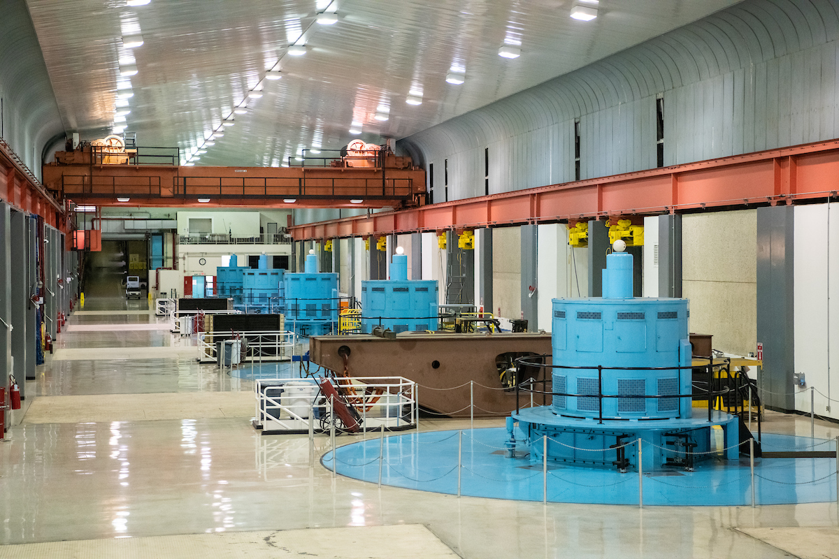
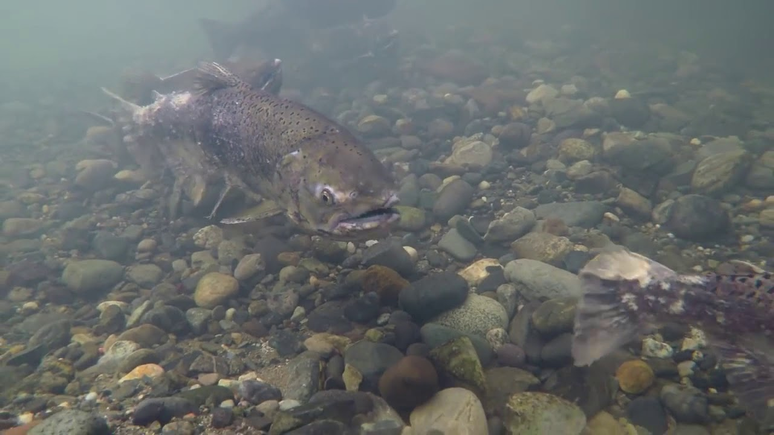
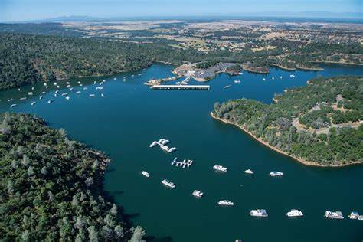
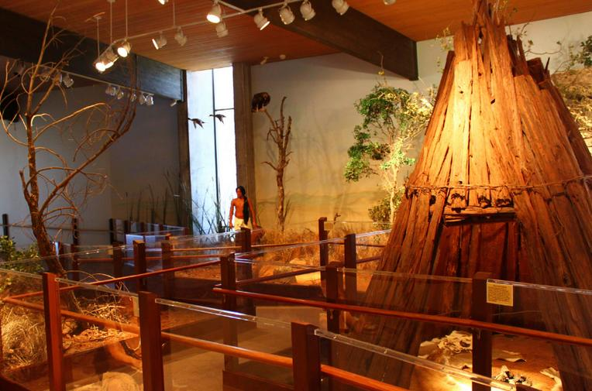
Key points of the Settlement Agreement
License Management
Environmental Management
01
04
02
03
Recreation Management
Historic Properties Management Plan
Notes:
Notes to presenter:
What did you think at first?
What obstacles did you encounter along the way?
How did you overcome those obstacles?
What images can you add to support your process?
This SmartArt allows you add images and text to help outline your process. If a picture is worth a thousand words, then pictures and words should help you communicate this reflection on learning perfectly! You can always click on Insert>SmartArt to change this graphic or select the graphic and click on the Design contextual menu to change the colors.
Feel free to use more than one slide to reflect upon your process. It also helps to add some video of your process.

Slide 21
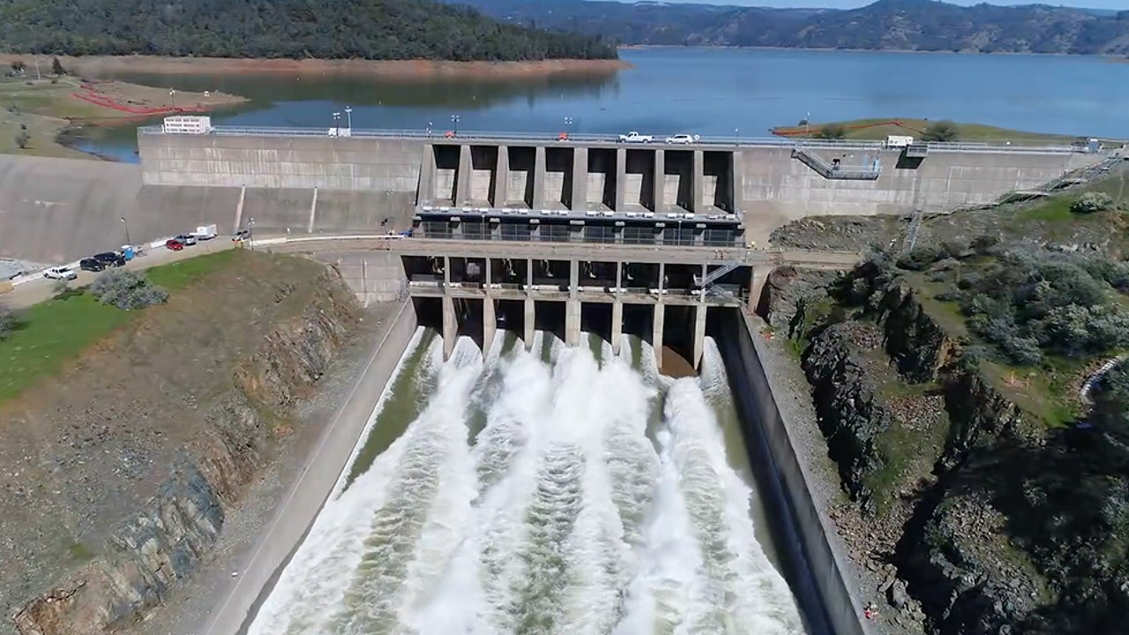
Importance
Relevance
Significance
License Management
The SA proposes enhanced stakeholder committees to provide advice to DWR
For the life of the approved new license. Adds protective measures to ensure that …
“promises” are “commitments”
Notes:
Notes to presenter:
What was important about this learning experience?
How is it relevant to your course, yourself, or your society or community?
Why is this significant?
This SmartArt allows you add images and text to help outline your process. If a picture is worth a thousand words, then pictures and words should help you communicate this reflection on learning perfectly! You can always click on Insert>SmartArt to change this graphic or select the graphic and click on the Design contextual menu to change the colors.

Slide 22
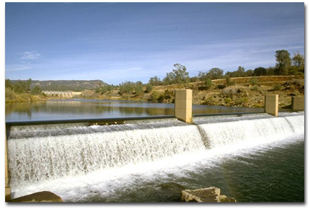
Importance
Relevance
Significance
Environmental Management
The SA calls upon DWR to manage water flows & temperatures, increase habitat & provide for other related actions benefiting salon, steelhead, riparian plants & wildlife.
Creates a time-line for implementing & maintaining these items.
Notes:
Notes to presenter:
What was important about this learning experience?
How is it relevant to your course, yourself, or your society or community?
Why is this significant?
This SmartArt allows you add images and text to help outline your process. If a picture is worth a thousand words, then pictures and words should help you communicate this reflection on learning perfectly! You can always click on Insert>SmartArt to change this graphic or select the graphic and click on the Design contextual menu to change the colors.

Slide 23
Importance
Relevance
Significance
Historical Properties Management Plan
The SA calls upon DWR to manage important historic and cultural resources with continuing input from Native Americans & other interested parties.
An establishment of a curation facility & expansion of DWR’s site stewardship program.
Notes:
Notes to presenter:
What was important about this learning experience?
How is it relevant to your course, yourself, or your society or community?
Why is this significant?
This SmartArt allows you add images and text to help outline your process. If a picture is worth a thousand words, then pictures and words should help you communicate this reflection on learning perfectly! You can always click on Insert>SmartArt to change this graphic or select the graphic and click on the Design contextual menu to change the colors.

Slide 24
Importance
Relevance
Significance
Recreation Management
The SA calls upon DWR to provide a new Recreation Management Plan that responds to recreation demand & addresses community interest in realizing the benefits of a robust & high quality recreation experience.
The Project Settlement Benefits Plan (SBF) allows the local region to plan & build projects which provide supplemental benefits outside of the project boundary.
Notes:
Notes to presenter:
What was important about this learning experience?
How is it relevant to your course, yourself, or your society or community?
Why is this significant?
This SmartArt allows you add images and text to help outline your process. If a picture is worth a thousand words, then pictures and words should help you communicate this reflection on learning perfectly! You can always click on Insert>SmartArt to change this graphic or select the graphic and click on the Design contextual menu to change the colors.

Slide 25
Supplemental Benefits Fund Partners Appendix B of the Settlement Agreement
Department of Water Resources (DWR)
State Water Contractors (SWC)
City of Oroville (City)
Feather River Recreation & Park District (FRRPD)
Notes:
Notes to presenter:
What is your purpose for sharing this reflection?
Is it at the end of a unit or project?
Are you sharing this reflection, at the attainment of a learning goal you set for yourself?
Is it at the end of a course?
State your purpose for the reflection or even the purpose of the learning experience or learning goal. Be clear and be specific in stating your purpose.

Slide 26
Purpose of Appendix B of the Settlement Agreement
Allow the benefits of the Oroville Facilities to be extended into the local communities in the vincity of the FERC boundary in a manner consistent with DWR’s authority to provide such benefits through operation of the State Water Project (SWP).
Notes:
Notes to presenter:
What is your purpose for sharing this reflection?
Is it at the end of a unit or project?
Are you sharing this reflection, at the attainment of a learning goal you set for yourself?
Is it at the end of a course?
State your purpose for the reflection or even the purpose of the learning experience or learning goal. Be clear and be specific in stating your purpose.

Slide 27
Appendix B of the Settlement Agreement
Measures agreed to among the parties but not to be included in the
New Project License
Establishes the City of Oroville as the SBF Fund Administrator
Establishes the SBF Steering Committee as the sole decision-maker, through majority vote of its members, to adopt the Fund Strategic Plan and select levels of funding for approved projects
Notes:
Notes to presenter:
What is your purpose for sharing this reflection?
Is it at the end of a unit or project?
Are you sharing this reflection, at the attainment of a learning goal you set for yourself?
Is it at the end of a course?
State your purpose for the reflection or even the purpose of the learning experience or learning goal. Be clear and be specific in stating your purpose.

Slide 28
DWR Commitment to Establish & Maintain the SBF Fund
Fifty year term: $1,000,000 per year
Forty-five year term $900,000 per year
Forty year term $800,000 per year
Any license term less than forty years, DWR shall use its discretion to determine the annual payment, if any, which will less then those listed above
Notes:
Notes to presenter:
What is your purpose for sharing this reflection?
Is it at the end of a unit or project?
Are you sharing this reflection, at the attainment of a learning goal you set for yourself?
Is it at the end of a course?
State your purpose for the reflection or even the purpose of the learning experience or learning goal. Be clear and be specific in stating your purpose.

Slide 29
DWR to provide “Good Faith” up-front funds to the SBF pending license approval
$11,270,000 of which $5,200,000 was committed to establish & build the first two phases of Riverbend Park
The balance of $6,070,000 to be used for establishing the Fund Strategic Plan, projects & administration
Notes:
Notes to presenter:
What is your purpose for sharing this reflection?
Is it at the end of a unit or project?
Are you sharing this reflection, at the attainment of a learning goal you set for yourself?
Is it at the end of a course?
State your purpose for the reflection or even the purpose of the learning experience or learning goal. Be clear and be specific in stating your purpose.

Slide 30
SWC & the SBF Steering Committee “Grant Funds Partnership”
SWC agree to develop, explore, work with the Fund Administrator & provide a staff resource in an amount not to exceed fifty percentage time of one FTE
The staffing, or funding, will be in effect until five years prior to the expiration of the new license
Notes:
Notes to presenter:
What is your purpose for sharing this reflection?
Is it at the end of a unit or project?
Are you sharing this reflection, at the attainment of a learning goal you set for yourself?
Is it at the end of a course?
State your purpose for the reflection or even the purpose of the learning experience or learning goal. Be clear and be specific in stating your purpose.

Slide 31
Reasoning behind the “grant writer clause”
Funds provided to the SBF from DWR are “un-escalated annual payments”
The intent was to assist the SBF in securing matches for approved projects
If there had been an “escalated” clause this is what todays annual payment would have been
$1,000,000 in 2007 would have been equal to
$1,470,809.25 in 2023
Notes:
Notes to presenter:
What is your purpose for sharing this reflection?
Is it at the end of a unit or project?
Are you sharing this reflection, at the attainment of a learning goal you set for yourself?
Is it at the end of a course?
State your purpose for the reflection or even the purpose of the learning experience or learning goal. Be clear and be specific in stating your purpose.

Slide 32
CRITICAL COMPONENTS OF THE SBF
Regional Fund Strategic Plan
4
SBF Mission Statement
3
2
SBF Project Priority Map
1
Feather River Consolidated Master Plan
Notes:
Notes to presenter:
What steps will you be taking as a result of this learning experience?
Did you learn from any failed experiences? How will you do things differently?
What advice will you give to others so they can learn from your experiences?
How can you share what you learned with a real-world audience?
Some examples of next steps might be:
After delivering my first persuasive presentation, I am thinking about joining the debate team.
After making my first film, I’m considering entering it in our school film festival or local film festival.
After connecting with this career expert, I’d like to do some research on that career field because it sounds interesting to me.
This SmartArt allows you add images and text to help outline your process. If a picture is worth a thousand words, then pictures and words should help you communicate this reflection on learning perfectly! You can always click on Insert>SmartArt to change this graphic or select the graphic and click on the Design contextual menu to change the colors.
Feel free to use more than one slide to share your next steps. It also helps to add some video content to explain your message.

Slide 33
REGIONAL FUND STRATEGIC PLAN (RFSP)
A requirement of Appendix B of the Settlement Agreement
The RFSP was approved on April 27, 2010 by the
SBF Steering Committee

Slide 34
REGIONAL FUND STRATEGIC PLAN (RFSP)
$350,000 was provided to hire a consultant to work with SBF staff to write the plan
The actual consultant cost was $173,050
The intention of the RFSP is to be a reference document for the SBF Steering Committee & a reference document for SBF grant applicants

Slide 35
SBF MISSION STATEMENT
“Investing in recreational and related projects with a nexus to the Feather River to improve the quality of life and stimulate economic development in the Oroville Region”

Slide 36
SBF DEFINITION OF “NEXUS”
Nexus is defined as the relationship of a project or program and/or connection with the Feather River, specifically in the area of the low flow channel:
On or in sight of the Feather River, or
Activities related to the Feather River, and
Within the geographic boundary of the SBF Priority Map

Slide 37
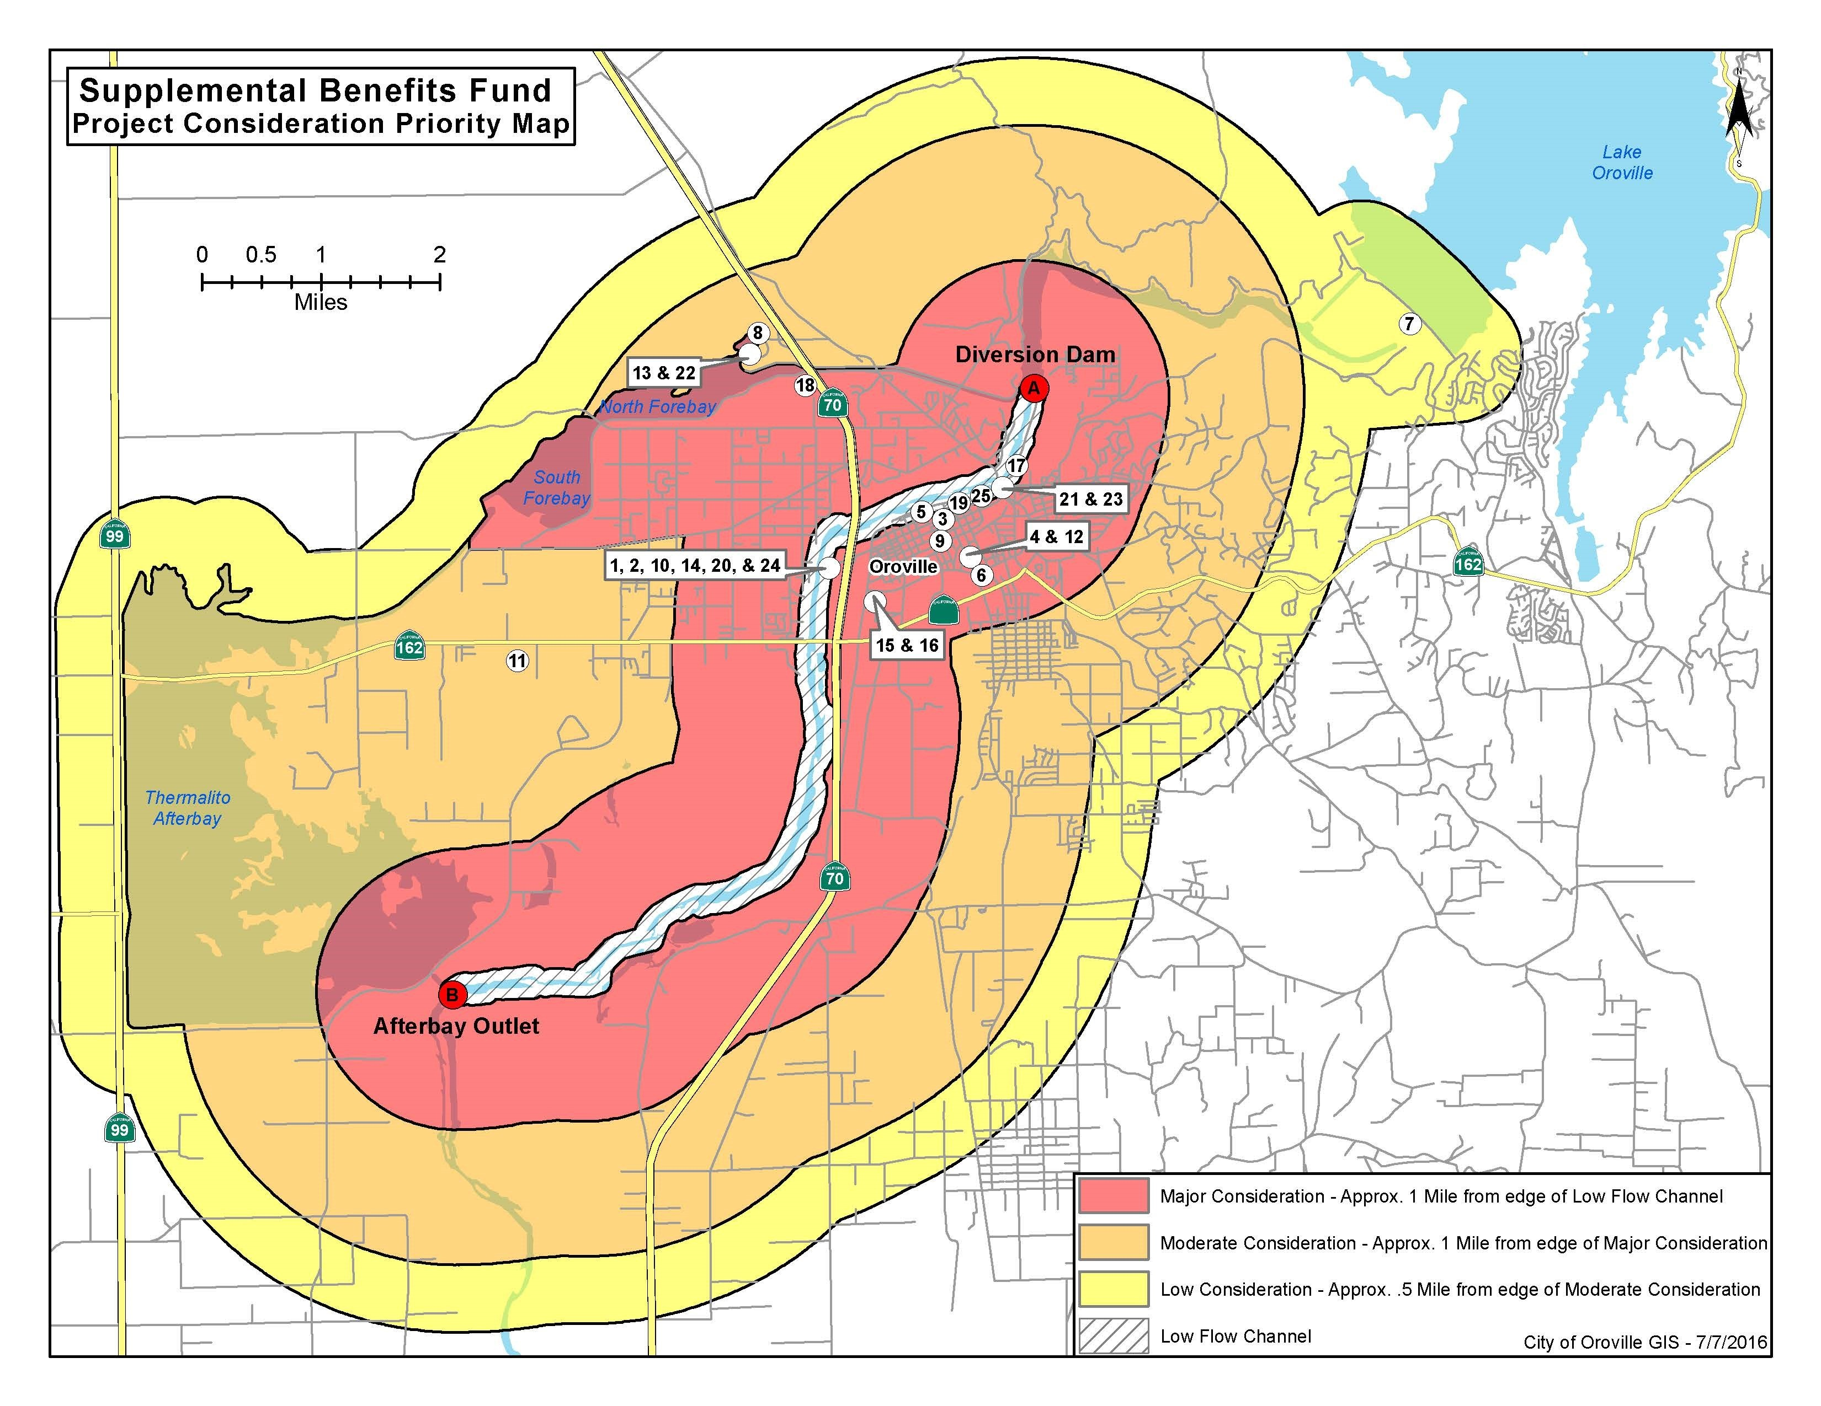
SBF PROJECT PRIORITY MAP

Slide 38
FEATHER RIVER CONSOLIDATED MASTER PLAN Approved, October 4, 2017
The Feather River Consolidated Master Plan was originally envisioned by the SBF Steering Committee as a way: to “consolidate” into a single document all the best ideas from existing Oroville plans and includes future river-related projects, that might best improve the quality of life and stimulate economic development in the greater Oroville Region.

Slide 39
FEATHER RIVER CONSOLIDATED MASTER PLAN
Six distinctive “Reaches”
Diversion Pool
Fish Barrier Pool
Historic Downtown
Riverbend Park
Oroville Wildlife Area
Thermalito Forebay

Slide 40
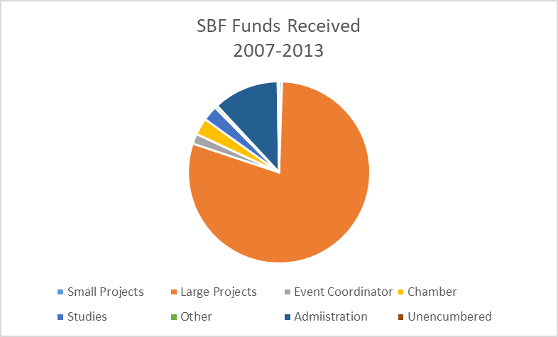
How have the “Advance” DWR funds of $11,270,000 to the SBF been used …
Small Projects .5%
Large Projects 79.6% *
Event Coordinator 1.8%
Oroville Chamber 3.0%
Studies 2.7%
Administration 11.7%
Other .5%
Unencumbered .2%
Total $11,270,000 100.0%
*Includes $5,200,000 for Riverbend Park

Slide 41
& sixteen years later we continue to wait for FERC to issue the license for the Oroville Project No. 2100

Slide 42
Questions ???????

