Slide 1
The billion dollar community benefit
Highlights of the $438,000,000 Recreation Components of the Settlement Agreement for the Oroville Project No. 2100

Slide 2
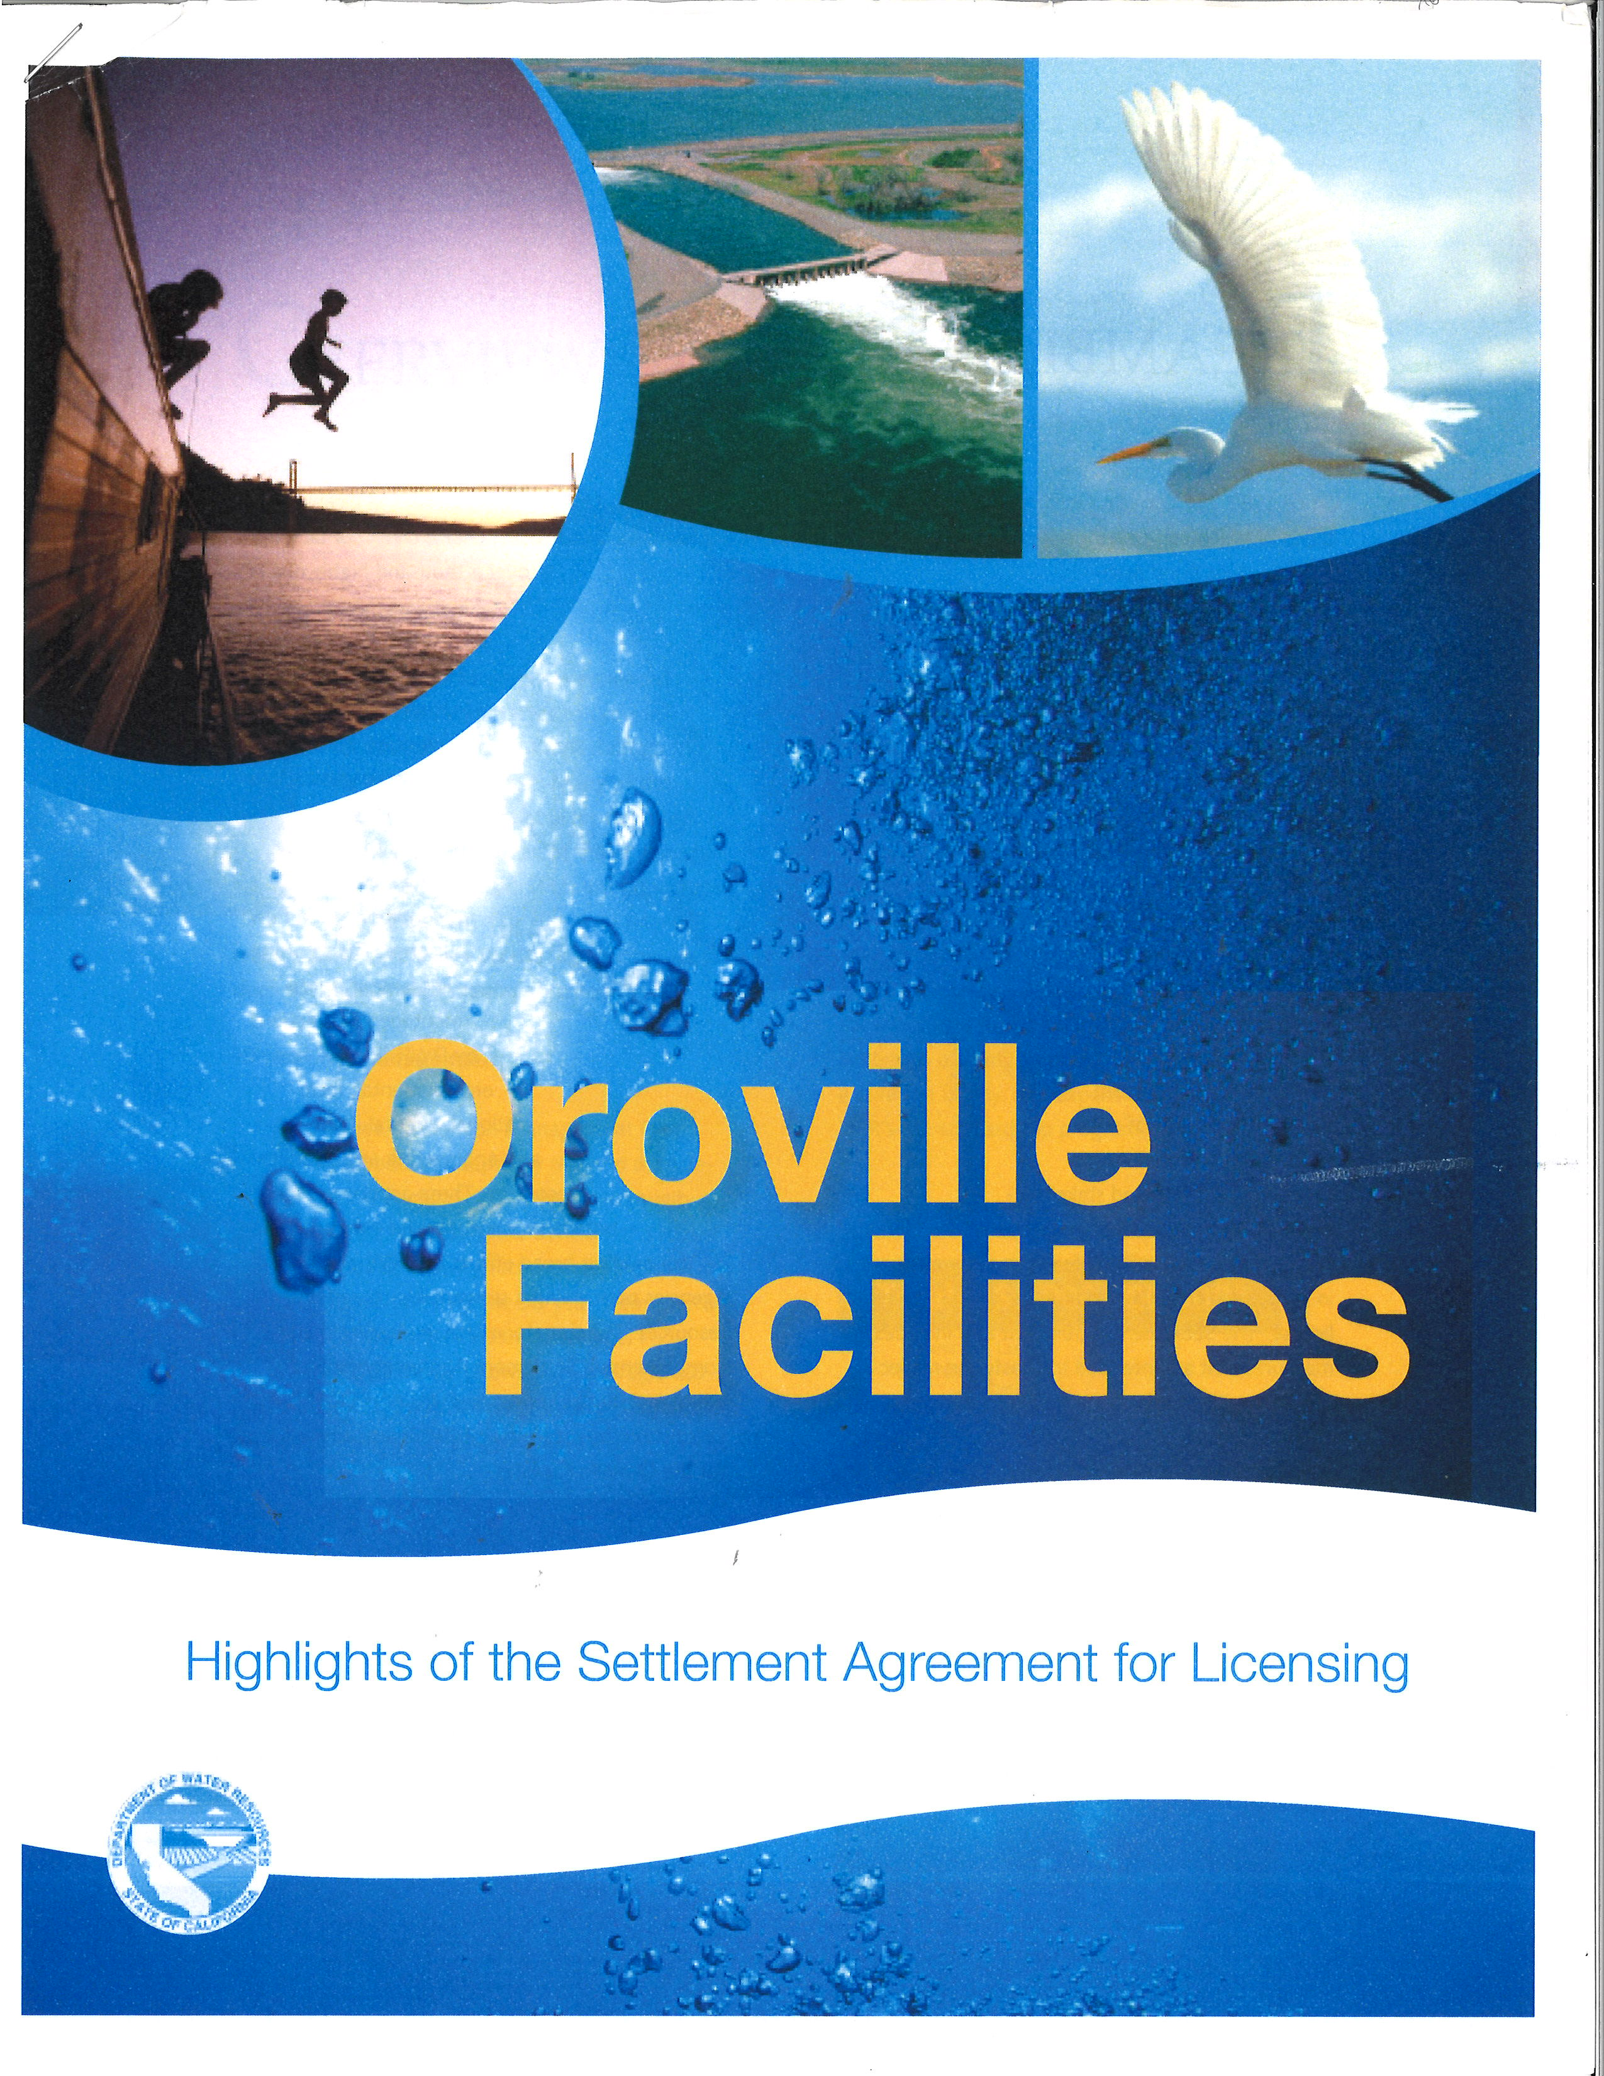
In 2006 DWR Published a 17 page
brochure for the community to help
understand the Settlement Agreement
THE BILLION DOLLAR COMMITMENT

Slide 3
The following slides detail the forty-nine recreation commitments totaling $438,000,000 that have been made to the Oroville Community

Slide 4
assumptions: A 50 FERC License is approved construction completed with years 1 to 10 Annual Cost to operate includes dwr overhead Total cost if a 50 year ferc license is approved
Oroville Community Component | Cost/Estimate | Years 1-10 | Annual Cost | Total 50 Years
Bidwell Canyon Complex | 9,268,000 | Yes | 775,000 | 38,750,000
Loafer Creek Complex * | 5,420,000 | Yes | 1,075,000 | 53,750,000
Lime Saddle Complex | 2,250,000 | Yes | 550,000 | 27,500,000
Oroville Dam Overlook Day Use ** | 200,000 | Yes | 25,000 | 1,250,000
Spillway Boat Ramp/Day Use Area | 50,000 | Yes | 625,000 | 31,250,000
Enterprise Boat Ramp | 3,500,000 | Yes | 200,000 | 10,000,000
* Includes feasibility study for new fresh water swim facility
** Completed 2012-2013

Slide 5
Beautiful lake oroville

Slide 6
Bidwell marina area

Slide 7
assumptions: A 50 FERC License is approved construction completed with years 1 to 10 Annual Cost to operate includes dwr overhead Total cost if a 50 year ferc license is approved
Oroville Community Component | Cost/Estimate | Years 1-10 | Annual Cost | Total 50 Years
Nelson Bar Car-top Boat Ramp | 50,000 | Yes | 50,000 | 2,500,000
Vinton Gulch Car-top Boat Ramp | 33,000 | Yes | 40,000 | 2,000,000
Dark Canyon Car-top Boat Ramp | 33,000 | Yes | 50,000 | 2,500,000
Foreman Creek Car-top Boat Ramp | 2,863,000 | Yes | 250,000 | 12,500,000
Stringtown Car-top Boat Ramp | 34,000 | Yes | 60,000 | 3,000,000
Lake Oroville Visitors Center | 200,000 | Yes | 425,000 | 21,250,000

Slide 8
Lake Oroville visitors center

Slide 9
assumptions: A 50 FERC License is approved construction completed with years 1 to 10 Annual Cost to operate includes dwr overhead Total cost if a 50 year ferc license is approved
Oroville Community Component | Cost/Estimate | Years 1-10 | Annual Cost | Total 50 Years
Boat-in Campgrounds (various) | 10,000 | Yes | 200,000 | 10,000,000
Lake Oroville Scenic Overlook* | 33,000 | Yes | 50,000 | 2,500,000
Floating Campsites | 375,000 | Yes | 228,000 | 11,400,000
Floating Restrooms | 0 | Yes | 260,000 | 13,000,000
Trails in the Lake Oroville & Dam Area | 269,000 | Yes | 50,000 | 2,500,000
Lake Oroville Facility Replace/refurbish | 0 | Yes | 400,000 | 20,000,000
* At the 162 bridge above the lake

Slide 10
Oroville dam overlook & interpretive signage

Slide 11
Floating campsites

Slide 12
assumptions: A 50 FERC License is approved construction completed with years 1 to 10 Annual Cost to operate includes dwr overhead Total cost if a 50 year ferc license is approved
Oroville Community Component | Cost/Estimate | Years 1-10 | Annual Cost | Total 50 Years
Diversion Pool DUA | 215,000 | Yes | 50,000 | 2,600,000
Trails in the Diversion Pool* | 316,000 | Yes | 50,000 | 2,500,000
Diversion Pool Area** | 0 | Yes | 20,000 | 27,500,000
North Thermalito Forebay Boat Ramp*** | 470,000 | Yes | 550,000 | 13,000,000
South Thermalito Forebay Boat Ramp**** | 200,000 | Yes | 115,000 | 5,750,000
Trails in the Thermalito Forebay Area | 225,000 | Yes | 25,000 | 1,250,000
* Low Flow Channel Area of the Feather River
** Low Flow Channel Area of the Feather River
*** Aquatic Center/RV Area
**** Day Use Area

Slide 13
Floating restrooms

Slide 14
assumptions: A 50 FERC License is approved construction completed with years 1 to 10 Annual Cost to operate includes dwr overhead Total cost if a 50 year ferc license is approved
Oroville Community Component | Cost/Estimate | Years 1-10 | Annual Cost | Total 50 Years
Thermalito Forebay Area Facility* | 0 | Yes | 40,000 | 2,000,000
Wilbur Road Boat Ramp/Day Use Area | 10,000 | Yes | 25,000 | 2,500,000
Larkin Road Car-top Boat Ramp | 250,000 | Yes | 50,000 | 2,500,000
Monument Hill Boat Ramp/Day Use Area | 0 | Yes | 100,000 | 5,000,000
Model Aircraft Flying Facility | 27,000 | Yes | 25,000 | 1,250,000
Thermalito Afterbay Area Facility** | 0 | Yes | 20,000 | 1,000,000
* Replacement & Refurbishment
** Replacement & Refurbishment

Slide 15
assumptions: A 50 FERC License is approved construction completed with years 1 to 10 Annual Cost to operate includes dwr overhead Total cost if a 50 year ferc license is approved
Oroville Community Component | Cost/Estimate | Years 1-10 | Annual Cost | Total 50 Years
Afterbay Outlet Area/Boat Ramp* | 2,450,000 | Yes | 300,000 | 15,000,000
Oroville Wildlife Area (OWA) | 400,000 | Yes | 32,000 | 1,600,000
OWA Facility Replacement & Refurbishment | 0 | Yes | 20,000 | 1,000,000
ADA Compliance Upgrades | 68,000 | Yes | 0 | 0
RMP Implementation | 0 | Yes | 119,000 | 5,950,000
Periodic Review Process | 100,000 | Yes | 20,000 | 1,000,000
* Day Use Area Campground

Slide 16
Afterbay area

Slide 17
assumptions: A 50 FERC License is approved construction completed with years 1 to 10 Annual Cost to operate includes dwr overhead Total cost if a 50 year ferc license is approved
Oroville Community Component | Cost/Estimate | Years 1-10 | Annual Cost | Total 50 Years
OWA Wildfire Evacuation Plan for Visitors | 50,000 | Yes | 10,000 | 500,000
OWA Additional Law & Regulation Enforcement | 250,000 | Yes | 166,000 | 8,300,000
Annual Lake Oroville July 4th Fireworks Show | 0 | Yes | 210,000 | 10,500,000
Locate FERC License Coordination Unit * | 0 | Yes | 75,000 | 3,750,000
Riverbend Park Phase I & II ** | 5,250,000 | Yes | 2,000 | 100,000
Bedrock Park Construction Boater Access | 5,000 | Yes | 2,000 | 100,000
* Within the City Limits
** Planning, Design & Construction…Fully Funded 2005

Slide 18
Lime saddle marina

Slide 19
assumptions: A 50 FERC License is approved construction completed with years 1 to 10 Annual Cost to operate includes dwr overhead Total cost if a 50 year ferc license is approved
Oroville Community Component | Cost/Estimate | Years 1-10 | Annual Cost | Total 50 Years
Rabe Road Shooting Range Improvements | 24,000 | Yes | 0 | 0
Whitewater Boating Op & Recreation Study* | 250,000 | Yes | 0 | 0
Analysis of Non-motorized Water Trail Access** | 100,000 | Yes | 0 | 0
DWR Contingency Adjustment | 0 | Yes | 0 | 21,953,000
* Completed in 2011 for a cost of $200,000
** The “Blue-line” kayaks, canoes, sailboats, etc.

Slide 20
Oroville forebay

Slide 21
Dwr appendix b commitments & project funding prior to ferc approval for project no. 2100 for licensing of the Oroville facilities
Commitment/Project | Dollar amount provided | Description | Timeline
Riverbend Park | 5,200,000 | Phase I & II | 2002-2006
SBF | 6,070,000 | Projects, studies, admin | 2006-2023
Whitewater Boating Study | 200,000 | Non-motorized study | 2008
Fuel-load Management | 1,500,000 | Wildfire prevention | 2012-2024
Feather River Salmon | 2,000,000 | Salmon Spawning Gravel | 2013-2014
Oroville Wildlife Plan | 100,000 | Develop Management Plan | 2012-2013
Feather River/flow/temps | 4,000,000 | Support Anadromous Fish | 2006-2014
Oroville Wildlife Area Total Appendix B | 26,200,000 40,420,000 | Law enforcement, staff, maintenance, operations, etc. | 2007-2012

Slide 22
Trails lake oroville

Slide 23
Other dwr interim settlement projects completed during the relicensing proceedings
Commitment/Project | Dollar amount provided | Description | Timeline
Enterprise Boat Ramp | 100,000 | Vault Toilet Building | Pre-2006
Saddle Dam Trail Access | 200,000 | Gravel path, toilet building | Pre-2006
Lake Oroville SR 162 | 15,000 | Fencing/interpretive signs | Pre-2006
Trails Diversion Pool Area | 110,000 | Sewim-Bo Trail, picnic tables | Pre-2006
Model Aircraft Flying Facility | 120,000 | Various improvements | Pre-2006
Loafer Creek Complex | 100,000 | Equestrian related | Pre-2006
Rabe Road Shooting Range | 10,000 | Grading/paving | Pre-2006
Total Interim/Other | 855,000

Slide 24
Oroville wildlife area

Slide 25
Other dwr community projects not specific to the settlement agreement
Commitment/Project | Dollar amount provided | Description | Timeline
Overlook, Trails, South Forebay, Monument Hill | 4,960,000 | Various improvements | 2008-2024
Spillway Emergency | 36,970,000 | “Recreation Offset” projects | 2017-2022

Slide 26
Supplemental Benefits Funds
$6,080,000 … released prior to FERC approval of the license …
& then if a 50 year license … $50,000,000 … $1,000,000 per year

Slide 27
$$$ Assumptions
A fifty year license term is approved which would provide $1,000,000 per year to the SBF less any adjustments for:
WATER DELIVERY SHORTAGES
(made up within five years of any actual reduction) or,
For ELECTRICAL ENERGY ADJUSTMENTS
(not made up, a hard dollar reduction)

Slide 28
DWR & Oroville Chamber of Commerce Highway 99 Billboards …just before the Hwy 162 turnoff to Oroville …

Slide 29
Now Show us the rest of the $$$$$

Slide 30
Questions … Comments …

